Slide 1
Fostering Peer-Peer Support for University of Pennsylvania Students with Disabilities
Weingarten SymposiumBodek Lounge
Weingarten Symposium March 8th, 2024
Lex Gilbert
Dale Brokaw

Slide 2
Agenda (60 minutes)
Introduction
Disabled Coalition (15 minutes)
Undergraduate Experience: Ableism (15 minutes)
Graduate Experience: Disparities in STEM (15 minutes)
Conclusion
Questions

Slide 3
Introductions
Lex Gilbert (they/she/he)
Dale Brokaw (they/them)
Founder and President of Disabled Coalition
Pre-law student studying Communication at Annenberg and Gender, Sexuality, and Women's Studies in the College of Arts and Sciences
Vice President of Disabled Coalition
PhD candidate in the Cell and Molecular Biology Program, Perelman School of Medicine
Studies liver genomics but also interested in pursuing career in science education and advocacy

Slide 4
The Disabled Coalition (DisCo)
Founded in 2022 for undergraduate and graduate students with disabilities
Serves undergraduate, graduate, and professional students at the University of Pennsylvania

Slide 5
The Disabled Coalition (DisCo)
DisCo was formed in response to absence of active student organization dedicated to disabled students following the pandemic
DisCo’s original mission was to provide a space for community– but has evolved into a larger advocacy organization

Slide 6
What’s in our name?
The Disabled Coalition (rather than Coalition of Students with Disabilities) centers an identity-focused definition of our organization
The Disabled Coalition challenges implicit associations by refusing to be merely the opposite of an “abled” coalition
The Disabled Coalition represents an active and vibrant community dedicated to increasing equity on our campus and throughout our communities

Slide 7
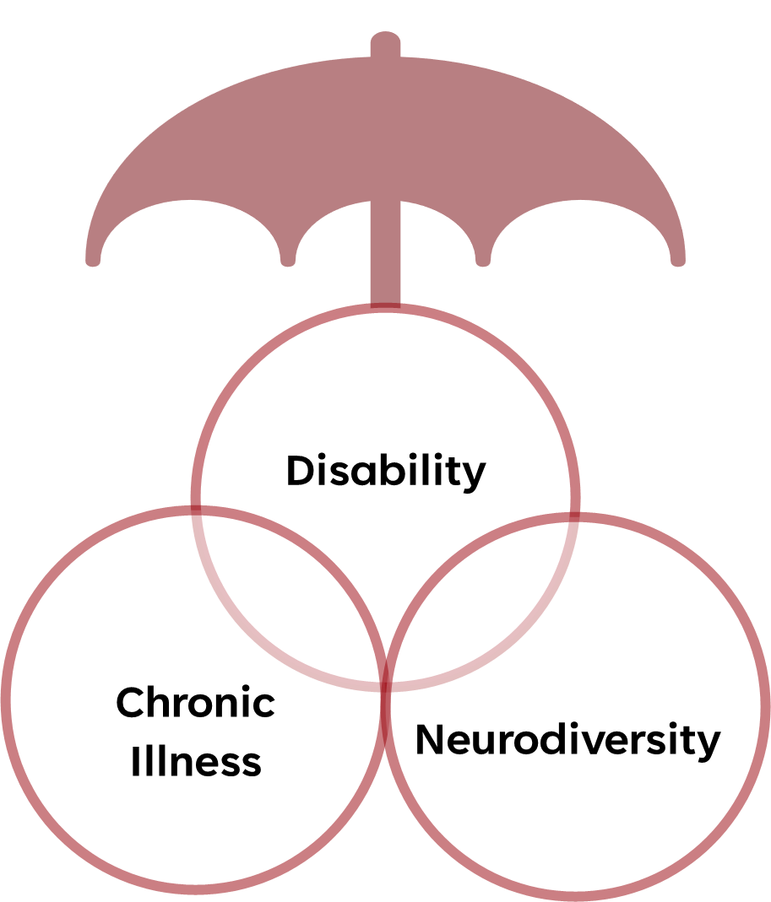
Who does the
Disabled Coalition Represent?
DisCo strives to represent students who access accommodations on campus
“Disabled” is an identity that does not resonate with every individual - and intersecting identities exist
Students may have invisible or visible disabilities

Slide 8
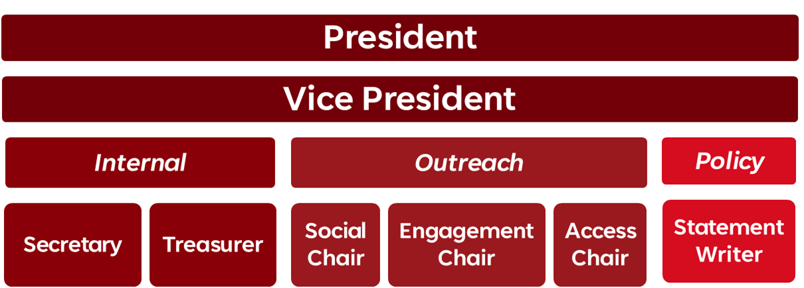
Disabled Coalition Organization
Organization layout supports advocacy and community-building approach–with specific focus on reaching students with disabilities
Notes:
Club is managed by President and Vice President in addition to Internal positions (Secretary and Treasurer)
Social Chair and Engagement Chair are responsible for producing educational materials and holding events. Access Chair is a unique position that ensures organization accessibility.
Statement Writer prepares statements for administration (University Council) and in response to current events.

Slide 9
Disabled Coalition Growth
Sustained growth of general members and board turnover over four semesters
Goal is to continually promote recruitment and sustainability of the organization so it may continue after we graduate

Slide 10
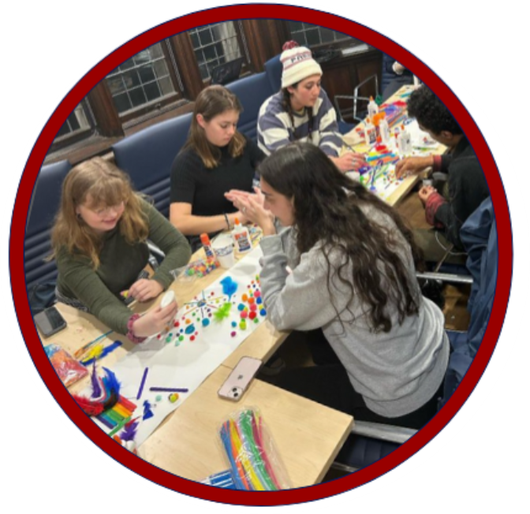
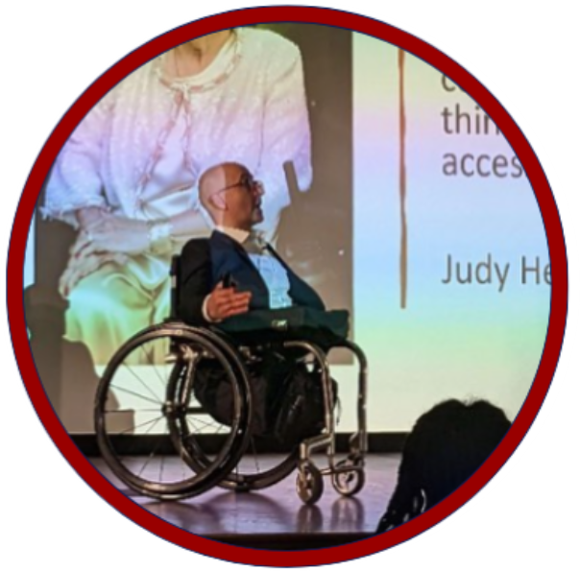
Disabled Coalition Events
Past Event Topics
Art and Wellness
Self-Advocacy
Accommodation Information
Speaker Invitation
Future Topics
Internalized Ableism
Wellness and Peer-Support

Slide 11
Disabled Coalition Initiatives
Educating Students on Accommodation Process (University Life, Weingarten Center)
Increasing Awareness of Disability and Ableism (Penn Wellness)
Advocating for Placement of Nap Pod Rest Stations (Undergraduate Assembly)

Slide 12
Student Experiences
Undergraduate Experience
Graduate Experience
Experiences of implicit and explicit bias from peers and professors
New to university life so they may not know how to self-advocate
Likely to struggle without accommodations due to lack of prior diagnosis
There is little awareness or visibility of disability in the graduate programs across campus
Accommodations outside the classroom are necessary to fit dynamic and diverse graduate school environments
Notes:
Make figure for this ---

Slide 13
Undergraduate Experience

Slide 14
Undergraduate Experience:
Many Disabled Coalition members report feeling fatigue, stress, and burnout from interactions with peers, professors, and staff (1)
Students feel they have to explain their condition in order to be taken seriously and have their accommodations implemented appropriately (1)
This experience is consistent with the definition of ableism
Notes:
Sources:
Discussions with students within the Disabled Coalition

Slide 15
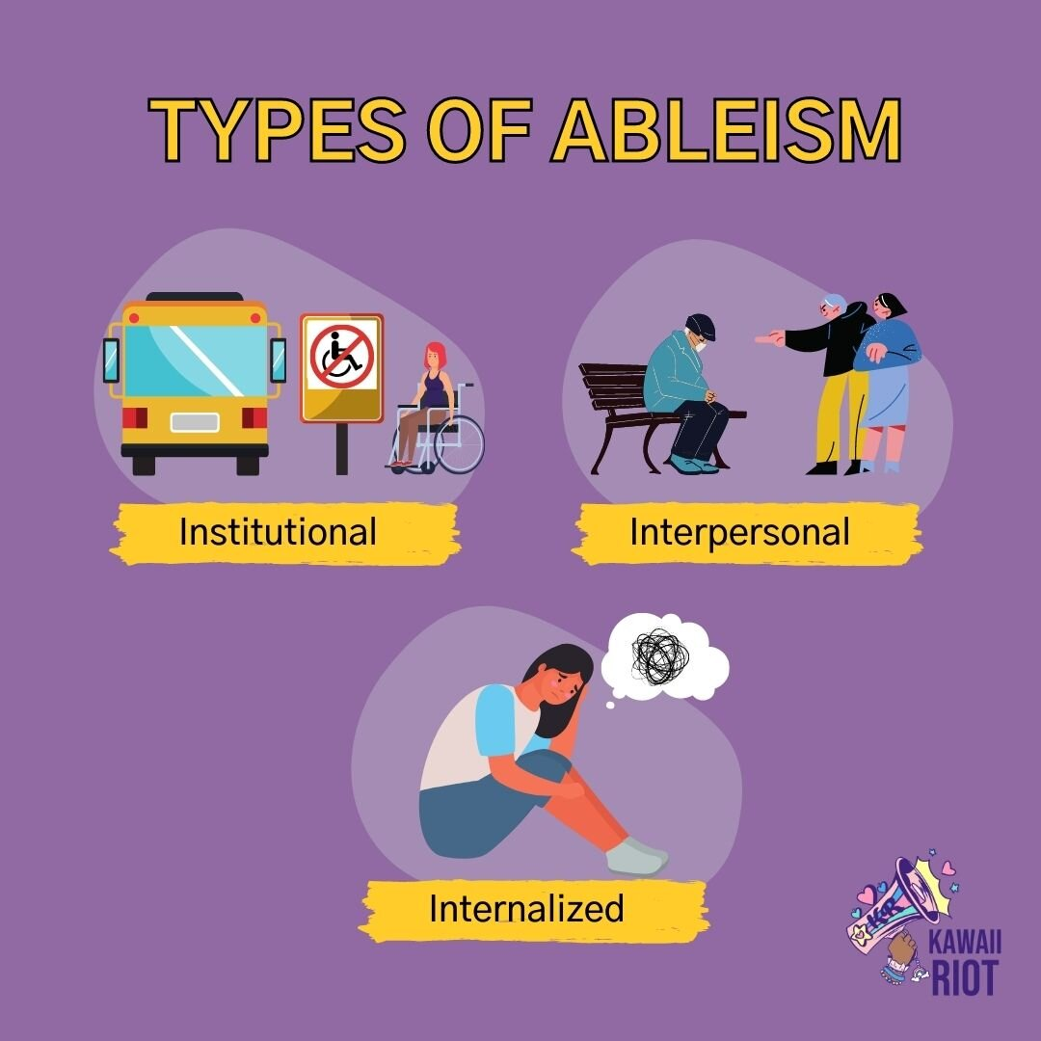

Slide 16
Definitions of Ableism
“Ableism is the discrimination of and social prejudice against people with disabilities based on the belief that typical abilities are superior.” (1)
Ableism can either be explicit or implicit (1)
Ableism can occur across an organization (institutional), between individuals (interpersonal), or internal (internalized ableism) (2)
Notes:
Sources:
Eisenmenger, Ashley. “Ableism 101 - What Is Ableism? What Does It Look Like?” Access Living, 3 Oct. 2022, www.accessliving.org/newsroom/blog/ableism-101/.
“Types of Ableism.” PainScale, www.painscale.com/article/types-of-ableism. Accessed 5 Mar. 2024.

Slide 17
Examples of Ableism
Institutional:
Classrooms with wheelchair seating only in back of room
Laboratory spaces without seated workspace option
Limited and unreliable transit options for students with disabilities
Interpersonal:
Professors using discriminatory and derogatory language in classrooms
Peers complaining about disabled students receiving accommodations for housing or on exams
Internalized:
Students holding themselves to a higher standard or feeling like they don’t deserve accommodations
Notes:
Source for image - https://www.kawaiiriot.org/kr101/ableism

Slide 18
Interpersonal Ableism
Opinion piece in student newspaper claiming time-extension accommodations are “unfair”
Author implied accommodations are a “crutch” for students with disabilities and that students receiving accommodations will not be competitive in the workforce
Notes:
Sources
Seaton, Brett. “Time Accommodations Need To Go.” The Daily Pennsylvanian, The Daily Pennsylvanian, 6 Dec. 2023, www.thedp.com/article/2023/12/time-accommodations-penn-opportunities-grades-benefits.
Can verbally mention more claims from the article

Slide 19
Interpersonal Ableism
The publication of this article resonated with many of our members’ experiences on campus
Reaction to the article was the single most active topic in the Disabled Coalition’s social channels since founding
Members voted to petition the Daily Pennsylvanian to either rescind the article or issue a rebuttal and contributed over 30 responses that directly informed the Disabled Coalition’s response to the Daily Pennsylvanian
Notes:
Sources

Slide 20
Snapshot of Response -
Student Words
“Time-based accommodations are crucial for both physical and cognitive disabilities, and to take the notion that it's one-size-fits-all and then share this is extremely harmful and incorrect….Disabled students are not ‘50% less efficient’ because they require more time.” - Disabled Coalition Member
“Allowing this article to be published contributes to the ableist narratives promoting stigma, and shame surrounding accommodations. Students should not feel pressured to forgo accommodations. Equity is about making sure all individuals have access to the necessary resources they need to thrive and succeed. As an individual who receives time-based accommodations, the article was incredibly invalidating.” - Disabled Coalition Member
Notes:
Sources

Slide 21
Snapshot of Response -
Student Words
“My accommodations don't give me an advantage. They bring me up to a level playing field amongst my peers. Try walking in my shoes without the support systems I've worked so hard to obtain and maintain. Then tell me my accommodations aren't fair. Try out having to miss class after class because of appointments, ER visits, flare ups; completing assignments on time when you haven't even had the chance to learn the material fully because of how time consuming it is to be disabled in college; feeling like you belong at an institution such as Penn when you have to work twice as hard against a system that wasn't made for people like you. Try all of that and then tell me that accommodations are unfair and that students need to work harder, manage their time better.” - Disabled Coalition Member
Notes:
Sources

Slide 22
Snapshot of Response -
Student Words
“Framing accommodations as something that serves as an ‘incentive’ to enable ‘lenient’ behaviors (and implying that it enables cheating) neglects all of the other difficulties that students with accommodations already face. Students do not unfairly profit off of their accommodations, they quite literally need them to stay in school…” - Disabled Coalition Member
“Having a condition that requires accommodations isn’t a choice or a lifestyle failure. Disabilities look different for everybody, and for many, they can’t be erased by simply ‘studying harder’ and trying ‘other methods’...” - Disabled Coalition Member
“Opinion-based articles should not spread hate towards any minority group. That is not an opinion —it’s discrimination.” - Disabled Coalition Member
Notes:
Sources

Slide 23
Ableism in STEM

Slide 24
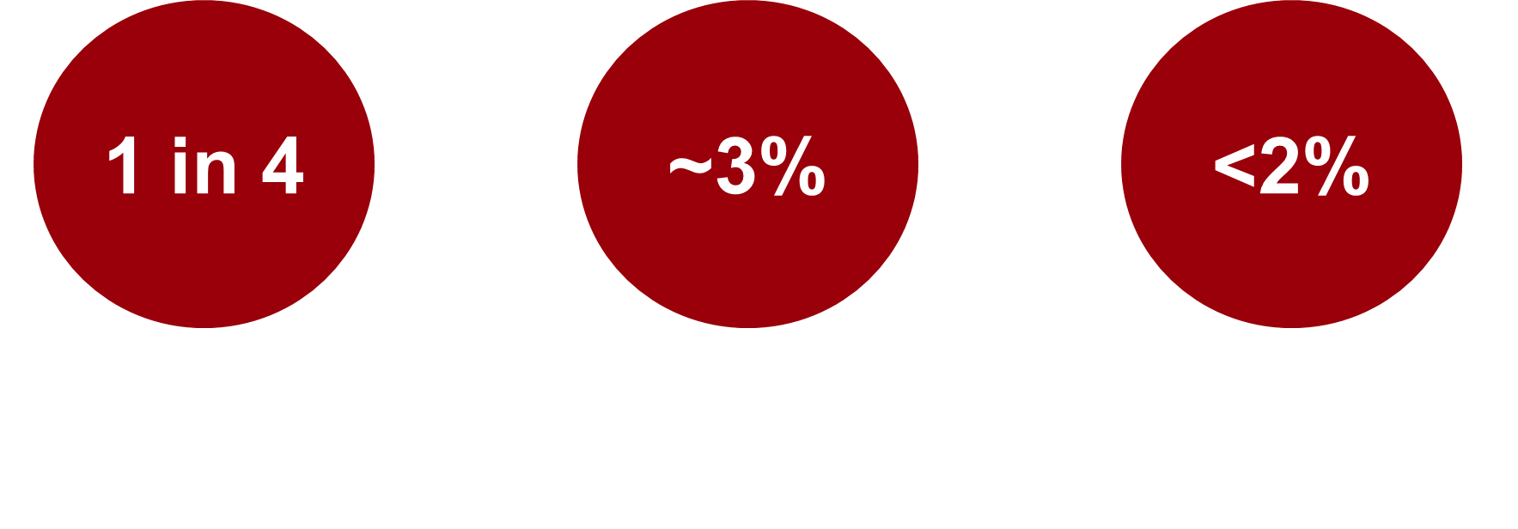
Disabled Scientists are Underrepresented in STEM
Notes:
Sources
1 - Okoro CA, Hollis ND, Cyrus AC, Griffin-Blake S. Prevalence of Disabilities and Health Care Access by Disability Status and Type Among Adults — United States, 2016. MMWR Morb Mortal Wkly Rep 2018;67:882–887. DOI: http://dx.doi.org/10.15585/mmwr.mm6732a3external icon.
2 - National Center for Science and Engineering Statistics. Diversity and STEM: Women, minorities, and persons with disabilites 2023. Nsf 23-315. Published online 2023:1-76. https://medium.com/@arifwicaksanaa/pengertian-use-case-a7e576e1b6bf
3- Swenor BK, Munoz B, Meeks LM. A decade of decline: Grant funding for researchers with disabilities 2008 to 2018. PLoS One. 2020;15(3):1-11. doi:10.1371/journal.pone.0228686

Slide 25
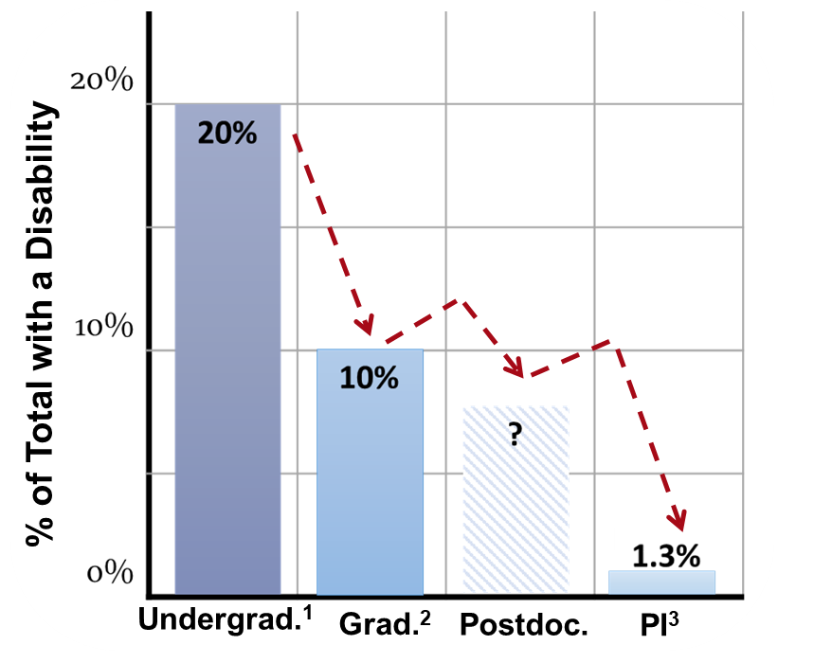
Why the Gap? From Undergraduate to PI
With each academic level, less researchers report having a disability (1-3)
Students diagnosed with a disability earlier in their career are less represented at later academic career stages (tenure) and report lower earnings (5)
Notes:
Sources -
1- Students with Disabilities in Higher Education - Census Overview. Postsecond Natl Policy Inst. Published online 2021.
2 - National Center for Science and Engineering Statistics. Women, Minorities, and Persons with Disabilities in Science and Engineering: 2021. Spec Rep NSF 21-321. Published online 2021:1-62. https://ncses.nsf.gov/pubs/nsf21321/report/introduction
3 - Swenor BK, Munoz B, Meeks LM. A decade of decline: Grant funding for researchers with disabilities 2008 to 2018. PLoS One. 2020;15(3):1-11. doi:10.1371/journal.pone.0228686
4- Castro F, Stuart E, Deal J, Varadaraj V, Swenor BK. STEM doctorate recipients with disabilities experienced early in life earn lower salaries and are underrepresented among higher academic positions. Nat Hum Behav. Published online 2023. doi:10.1038/s41562-023-01745-z
5- “Advancing Disability Inclusion in the Scientific Workforce.” National Institutes of Health, U.S. Department of Health and Human Services, diversity.nih.gov/blog/2021-07-21-advancing-disability-inclusion-scientific-workforce#:~:text=Of%20all%20graduates%20awarded%20doctoral,having%20one%20or%20more%20disabilities. Accessed 5 Mar. 2024.

Slide 26
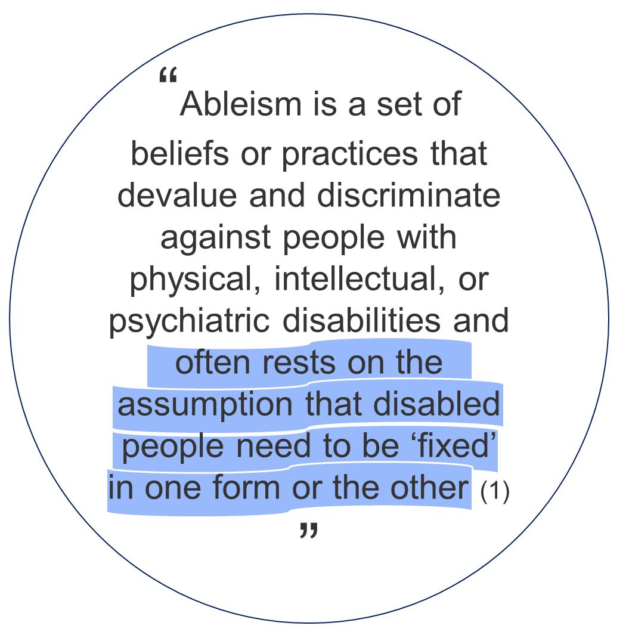
Definitions of Disability
Social Model (1)
•Disability is of an aspect of a person’s identity
•Disability is a mismatch between the person and the environment
•The way to address disability is to change the environment and society, rather than people with disabilities
Biomedical Model (2)
•Disability is an impairment in a body system or function that is inherently pathological
•The person’s disability makes it difficult for the person to exist in society
•The goal is to return the system or function to as close to normal (a.k.a abled) as possible
Notes:
Sources -
1 - https://cdrnys.org/blog/uncategorized/ableism/
2- https://www.apa.org/ed/precollege/psychology-teacher-network/introductory-psychology/disability-models

Slide 27
Glacier Model
Stigma – questioning whether a student with a disability can do the workload, necessity of accommodations, description of patient samples, etc.
Burnout – exhaustion from advocating for access, feeling the need to “earn” accommodations by demonstrating excellence, etc.
Exclusion – accommodations result in social segregation, isolation, or discrimination by faculty or peers
Notes:
while we are focusing on STEM in this section of the presentation, we know that these themes can be applied to other fields

Slide 28
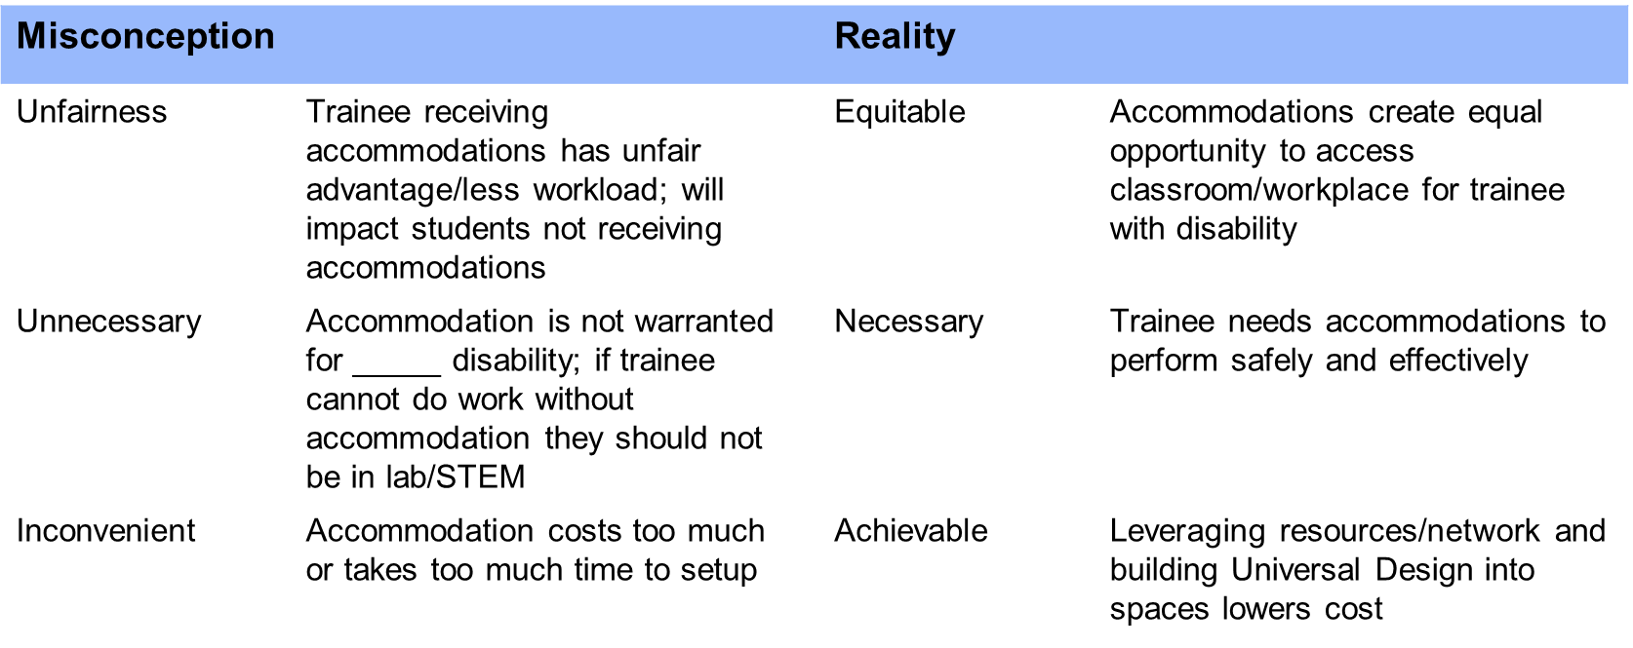
Common Misconceptions about Accommodations
Notes:
Remind that these are real experiences that our peers have told us about and that we ourselves have had to combat
Table Contents from Alt Text
Table with two columns. On the left side, misconceptions about accommodations are listed; on the right side, the reality about accommodations is listed.
The first misconception is that accommodations create an unfair advantage for the trainee and impacts students not receiving accommodations; the reality is accommodations are equitable and create equal opportunity to access classrooms and workplaces.
The second misconception is that accommodations are not necessary for certain disability or that if trainee requires accommodations they should not be in a lab or STEM. The reality is that accommodations are necessary for trainees to perform safely and effectively.
The final misconception is that accommodations are inconvenient because they cost too much or take too much time to set up. The reality is that accommodations are achievable when campus resources and partners are utilized, and when Universal Design is considered when designing spaces or materials.

Slide 29
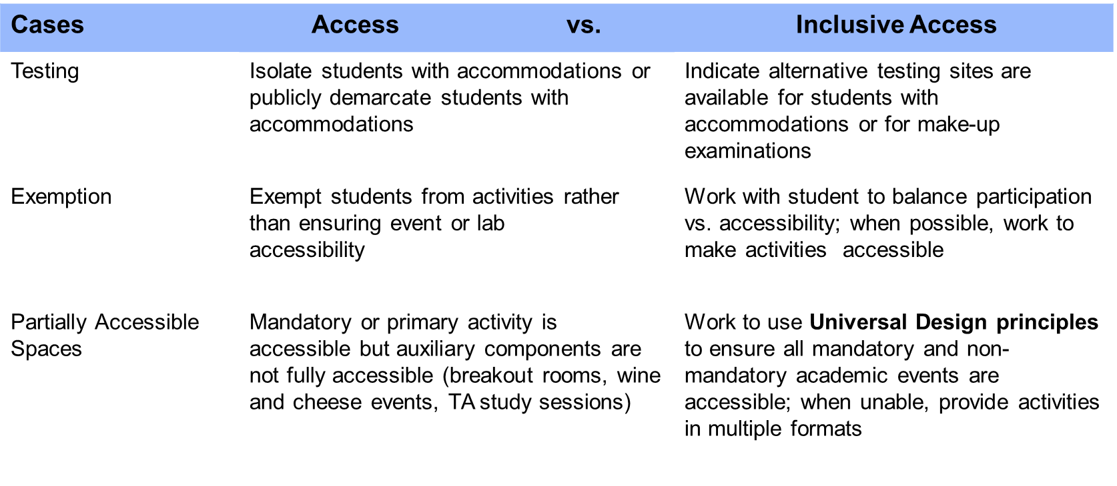
Balancing Access and Inclusion
Notes:
Table Contents from Alt Text
Table with three columns. Each row lists example instances where access (second column) versus inclusive access (third column) need to be balanced.
The first row is about Testing. An accessible solution is isolating students with accommodations in separate classrooms or otherwise publicly demarcating students who receive accommodations. An inclusive accessible solution is indicating alternative testing site or location for students with accommodations or make-up examinations.
The second row is about exemption from activities. An accessible solution is exempting students from activities that are not accessible rather than modifying the event or lab to create accessibility. The inclusive solution is to work with the student to balance participation versus accessibility, and when possible work to make all activities accessible.
The third row discusses partially accessible spaces. An accessible solution is making mandatory or primary activities accessible but not ensuring that auxiliary components--such as breakout rooms, wine and cheese events, TA study sessions-- are accessible.

Slide 30
Moving Forward
Disabled Coalition working with the Cell and Molecular Biology Program and Training Advocacy Alliance to increase awareness of issues that impact trainees with disabilities.
Similar issues are prevalent throughout graduate student programs–require program-by-program approach to increase accessibility and inclusion.
Disabled Coalition working with the Cell and Molecular Biology Program and Training Advocacy Alliance to increase awareness of issues that impact trainees with disabilities
Similar issues prevalent throughout graduate student programs–require program-by-program approach to increase accessibility and inclusion

Slide 31
Special Thanks To:
Current Disabled Coalition Board
Khush Sabuwala (Board Member, 2022-2024)
Sophie Kadan (Social Chair, 2023-2024)
Pablo Czerkas (Secretary, 2024)
Zawadi Sankofa (Policy Writer, 2024)
Ciara Byrne (Engagement Chair, 2024)
Past Board Members
Alyssa Meyer (Access Chair, 2023)
Hannah Cirincione (Secretary, 2022-2023)
Haydr Dutta (Treasurer, 2022-2023)
And to all the members of the
Disabled Coalition!
Campus Partners
Penn Wellness
University Life
Hikaru ‘Karu’ Kozuma
Sharon Smith
Will Atkins
Weingarten Center
Jane Holohan
Aaron Spector
Training Advocacy Alliance
Dan Kessler
Student Groups
Dean’s Advisory Board for the College of Arts and Sciences
Advocates for Neurodiversity (AND)
Stutter Strong
Disabled & Allied Law Students (DALSA)
Wharton’s Disability Empowerment and Action League (DEAL)

Slide 32
Questions?
Instagram - @TheDisabledCoalition
Email - disabledcoalition@gmail.com
Lex - lexsare@sas.upenn.edu
Dale - brokawd@pennmedicine.edu

