Slide 1
Crucial Collaborations: A Practical Framework to Ensure Access, Equity, and Inclusion for Students with Disabilities
22nd Annual Weingarten Center Disability Symposium
University of Pennsylvania
March 8, 2024
Philadelphia, Pennsylvania
Michael Berger, PhD, MBA, Professor of Chemistry, Simmons University
Neal Lipsitz, PhD, Associate Dean for Student Wellbeing/Director of Student Accessibility Services, College of the Holy Cross
Eileen Berger, M.S. Ed, Assistant Director Student Affairs, ADS Administrator, Harvard University GSE, retired

Slide 2
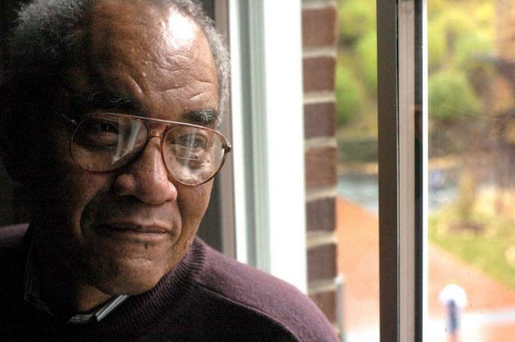
Land Acknowledgement
The town of Worcester, MA is located in the tribal homelands of the Nipmuk people. The town of Brookline, MA is located on the tribal homelands of the Massachusett people.
We acknowledge the history of oppression that has dispossessed indigenous people of their lands and we honor and respect the diverse and beautiful peoples still connected to this land.
Thomas L. Doughton

Slide 3
Disability Acknowledgement
We acknowledge the history of neglect and exclusion of students with disabilities from the ‘goals of academic excellence and social justice’. (AAC&U 2018) We acknowledge students with visible and non-visible disabilities in higher education who are often forgotten in HE Diversity conversations and initiatives.
We honor and respect the diverse and beautiful people with disabilities among us who deserve access, recognition, resources, fairness and equity.

Slide 4
AGENDA
Introductions
What is a “reasonable” accommodation?
Case Study Introduction
Presentation of the Framework
Case Study Analysis
The Importance of Collaboration and Process
Audience input, Q&A, Discussion

Slide 5
What is a “reasonable” accommodation?
Non-curricular
Housing
Dining
Transportation
Academic

Slide 6
“Reasonable Accommodation” Means
Something necessary and effective to enable a student with a disability to have the same opportunity to meet the academic and technical requirements of the recipient’s programs and activities as nondisabled students. US Airways v. Barnett, S.Ct. (2002).
“Necessary” does not mean that without an accommodation it is impossible for the student to participate in the program or activity. Necessary is a relative term, meaning necessary to have an equal opportunity to participate in the program and activities of the recipient. Argenyi v. Creighton University, 8th Cir. (2013). Conversely, the duty to accommodate a student with a disability does not include a guarantee of success or a particular GPA for that student.
Reasonable accommodation may require an exception to a long-existing, written, consistently-followed rule: (PGA Tour Inc. v. Martin, S.Ct. (2001); Doe v. Samuel Merritt College, N.D. Cal. (2013).
Paul Grossman, J.D. (now Executive Counsel, AHEAD), “Life After the ADAAA: Principles of Reasonable Accommodation,” Harvard GSE (May 2, 2014).

Slide 7
Is There Any Limit to the Duty to Accommodate?
Nothing is inherently exempt from the duty to accommodate. In the proper circumstances, the duty to accommodate may include:
Weekly homework
Papers to be done at home
Internships
Laboratory exercises
Based on interactive and diligent consideration of the range of feasible and effective accommodations, different settings may require different accommodations. For example, accommodated homework deadlines may have to take into account course continuity.
No specific accommodation is required that entails a fundamental alteration or an undue burden. Neither defense is likely to be successful unless the product of a careful diligent consideration process. Wynne v. Tufts Medical School of Medicine, 1st Cir (1991). Undue burden defenses may be based on administrative feasibility or financial cost. However, financial consideration defenses are almost never successful.
Paul Grossman, J.D. (now Executive Counsel, AHEAD), “Life After the ADAAA: Principles of Reasonable Accommodation,” Harvard GSE (May 2, 2014).

Slide 8
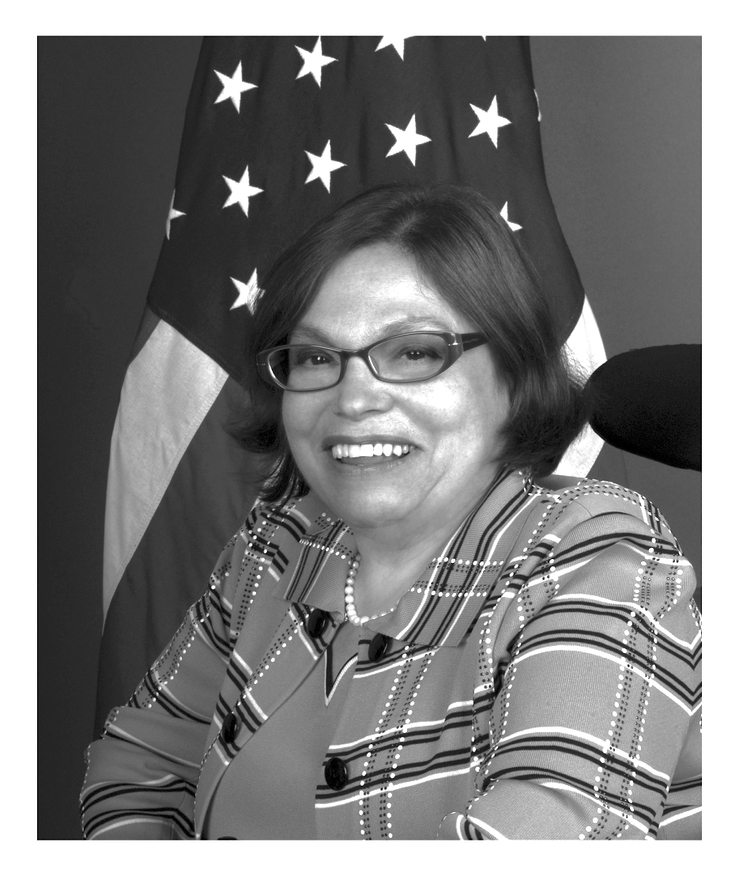
Judy Heumann in Memoriam
“Part of the problem is that we tend to think that equality is about treating everyone the same, when it’s not. It’s about fairness. It’s about equity of access.”
Judith Heumann, Being Heumann: An Unrepentant Memoir of a Disability Rights Activist

Slide 10
Post-COVID college students
2020: 71% of students indicated increased stress and anxiety due to the COVID-19 outbreak.
- J Med Internet Res. 2020 Sep; 22(9): e21279.
2020-2021; 60% of students meet the criteria for at least 1 MH problem
(Lipson , S. K., Journal of Affective Disorders, Vol. 306, 2022)
2021: “In another national survey, almost three quarters of students reported moderate or severe psychological distress.” (National College Health Assessment, American College Health Association, 2021)
2022/2023: According to the National Center for Education Statistics (NCES), ~ 20% of undergraduate and ~ 12% of graduate students reported having a disability
A large number of SWD do not report their disability to their college.
Many SWD who report their disability don't receive accommodations from their school

Slide 11
College Students: Mental Health Stats post-Covid
Innovative Educators May 10, 2023

Slide 12
Anxiety
Students with anxiety and depression require greater medical, psychological, social, and academic support from institutions and families when symptoms are exacerbated.
Post pandemic, what was once clearly an unreasonable accommodation, unduly burdensome or a fundamental alteration is suddenly changed. Schools are now required to consider providing hybrid, distance and more complex learning accommodations that require consultation and collaboration.

Slide 13
Brianna: The Global Studies Conundrum
Student requests Foreign Language Waiver via Accessibility Services
Student wishes to major in Global Studies which has a Foreign Language Requirement
Global Studies faculty want to abide by Department policy
Class Dean is caught between advocacy for student and college policy
Accessibility Services determines student is qualified for a foreign language waiver
Parents advocate for student

Slide 14
Student Issues
Manifest by
Faculty Questions
General Uncertainty of the future
How to make the classroom
experience a meaningful
part of the course?
Changing
Workforce
Anxiety
Poor
Attendance
Changing Pedagogy
AI and chat GPT
When does a general
anxiety become a disability?
Post - COVID
Inadequate
Preparation
How to provide effective
scaffolding for
student learning?
Effect of Technology on new methods of Learning
Procrastination
How to engage a wide spectrum
of students in the required content?
Competing Demands
($$, Social catch-up)
Defocus
Lack of
Engagement
How to maintain Academic Rigor?

Slide 15
Faculty conundrum
How can I modify the course and create a better environment to equitably engage a wider range of students and still retain the required academic rigor in the content?

Slide 16
Accommodating Today’s Students
Universal Design Principles make courses more accessible to all students
Make the classroom experience a meaningful part of the course
New pedagogies- videos-talk and turns-flipped classes-research teams-personalizing content-record classes- post homework-online office hours-etc
Provide effective scaffolding for student learning-
study groups- on line homework sessions- grading techniques-peer learning associates in lab and classroom
Engage a spectrum of students in required content
Working groups-service learning-partnerships with academic supports-co-curricular learning opportunities.-co-teaching with partnerships-guest speakers

Slide 17
Accessibility Services Stressors
Burn out
Complex accommodation requests
Legal Liability
Changing Assistive technology
Real time access
Funding
Staff turnover
Parents

Slide 18
Administration Stressors
Political Climate
Changing workforce demands
Funding
Enrollment
Academic Freedom
Students at Risk

Slide 19
Parent Stressors
Cost of Education (ROI)
Students may not be prepared academically (Post-Covid)
Students may not be appropriately socialized (Post-Covid)
IEPs are not accepted in college
FERPA, HIPPA legal restrictions on parent involvement
Neuropsychological evaluations are expensive but often required

Slide 20
Advice for Parent the first year of college for students with anxiety, ADHD, depression, OCD
New stresses can elicit overwhelming challenges
Consider a college near enough to make weekly visits home a practical option.
Enroll as a daily commuter, living at home in the first critical year of transition
Students on meds- worked in high school but not enough in college
Create a safety net-
Arrange monthly follow ups with current clinicians or a backup near campus, college counseling has a resource list
Line up supports before you will think you need them.
Hibbs & Rostain (2019) The Stressed Years of Their Lives. St. Martins Press.
Notes:
What is an effective new role for parents
Some sage advice from Dr Rostain and dr Hibbs
Transition to higher education especially the first year
10 practical tips for parents of students with disabilities
Rostain, a psychiatrist U Penn and Dr Hibbs, a clinical psychologist wrote this book out of years of practice with college students and with personal experience. Dr Hibbs’ son and dr Rostine write the book around Dr Hibbs’ son’s experience in his first year of college.
Avoiding some of the stresses and pitfalls of living at a college or university…Res. Hall life is a whole new world…
As a parent..i have exp. This with my own kids…we all stuck together and got thru it BUT…things happen that your kids are not prepared for…

Slide 21
How parents can be helpful to their student
Tell your student if they get in any trouble of any kind, you want to hear about it! Without accustomed feedback from family and familiar friends problems escalate silently.
Encourage your student to join clubs and campus activities to connect socially.
Assist student in identifying key support personnel and services such as campus tutoring, the Access Disability Services, college counseling and student health.
Professors and counselors can not report absences or other concerns to parents due to confidentiality laws (FERPA, HIPPA, etc.)
Encourage your student to waive FERPA confidentiality and privacy protections, this empowers you to speak with campus staffers( professors and advisors) and receive alerts from them before a course failure or a crisis ensues. Do the same with counselors or therapists with signed HIPPA forms on file.
Hibbs & Rostain (2019) The Stressed Years of Their Lives. St. Martins Press.
Notes:
Counseling office function under HIPPA regs. That are more stringent b/c they are considered confidential…you can create a waiver for counseling separate from DS/registrar etc.

Slide 22
Stakeholder Priorities in the case
Student – Requests foreign language waiver due to a learning disability and anxiety
Faculty – Academic rigor and integrity, adherence to policy, concern about fundamental alteration
Accessibility Services – Advocacy, make sure that disability law is followed, remove barriers to student’s education, provides reasonable accommodations, promotes collaboration to optimize outcomes
Administration – Disability law compliance, academic integrity, inclusion, academic support for student, financial issues, policy changes, setting a precedent?
Parents/Guardians – Student rights to pursue academic interests, preparation for future career, ROI

Slide 23
Through what lenses do stakeholders view this case?
Let’s talk more about the different priorities and perspectives of the Stakeholders and how they can affect equity and inclusion for students with disabilities
Now we know the stakeholders and what’s on their plate
We also know that they also have roles and responsibilities
Each stakeholder looks at a particular case through different lenses.
Let’s take a look at these lenses….

Slide 24
The “Lenses”

Slide 25
The “Lenses”

Slide 26
The “Lenses”

Slide 27
The “Lenses”

Slide 28
The “Lenses”

Slide 29
The “Lenses”

Slide 30
The “Lenses”

Slide 31
The “Lenses”

Slide 32
The “Lenses”

Slide 33
SWD
Self - Advocacy
Individual Differences
Life Transition
Socialization Inclusion
Academic Rigor
Attitudes
Technology
New Pedagogy
Disability Law
Administration
Faculty
Notes:
We need a more useful graphic than the student centered approach to help analyze the myriad interactions of SWD with other stakeholders at the academic institution. From the SWD’s vantage point the major points of contact with the “academic institution” are the “faculty” and the “administration” most often represented by the office of student affairs and the office of access and disability services. To understand the complexity of interactions that are required amongst the major stakeholders to bring about a successful educational experience it is instructive to map the degree of ownership and responsibility for a particular lens into a space defined by the relative amount of interest and influence of the student, the Administration, and the Faculty. See figure 2. The closer the lens is mapped to an apex of the triangle, the greater the interest, influence, or responsibility of that stakeholder. Thus Self Advocacy is brought about mainly by the SWD, New Pedagogy is the main concern of the Faculty, and Technology is planned and implemented by the Administration. Some lenses are shared by only two of the stakeholders. For example, keeping current with the requirements of Disability Law usually falls to the Office of Disability Services, but working with Faculty to ensure compliance is essential for successful implementation. Academic Rigor is largely the responsibility and concern of Faculty who must work with SWD to assure appropriate accommodations are in place. And the Administration together with the Faculty are responsible for the culture of the institution (attitudes of the faculty and staff towards SWD). Some lenses, such as socialization/inclusion, require the cooperative effort of each Stakeholder.

Slide 35
Brianna: The Global Studies Conundrum
Student requests Foreign Language Waiver via Accessibility Services
Student wishes to major in Global Studies which has a Foreign Language Requirement
Global Studies faculty want to abide by Department policy
Class Dean is caught between advocacy for student and college policy
Accessibility Services determines student is qualified for a foreign language waiver
Parents advocate for student

Slide 36
What to look for in this case…
Academic Aspects
Academic Rigor
Fundamental alteration
Degree completion
Precedent setting
Social Aspects
Inclusion
Belonging
Impact of Technology
Accessibility Services Responsibilities
Disability Law compliance
Reasonable accommodations
Collaboration
Understanding opposing perspectives
Can opposing needs be met?
Getting to “Yes”?

Slide 37
Stakeholder Priorities in the case
Student – Requests foreign language waiver due to a learning disability and anxiety/OCD
Faculty – Academic rigor and integrity, adherence to policy, concern about fundamental alteration
Accessibility Services – Advocacy, make sure that disability law is followed, remove barriers to student’s education, provides reasonable accommodations, promotes collaboration to optimize outcomes
Administration – Disability law compliance, academic integrity, inclusion, academic support for student, financial issues, policy changes, setting a precedent?
Parents/Guardians – Student rights to pursue academic interests, preparation for future career, ROI

Slide 42
Wynne v. Tufts Collaborative Process
Based on the Wynne decision and the many judicial and OCR decisions that followed it, the demonstration of duty is met when a school:
1. Convenes a committee of relevant administrators and faculty, possibly including an Accessibility Services representative.
2. The committee carefully reviews the student’s proposed accommodation to determine whether it is compatible with or defeats one or more of the essential objectives of the program in which the student is enrolled or that implementation of the proposed accommodation would lower an essential academic standard.
3. If the proposed accommodation defeats essential program objective, the school must search for alternate accommodations that are compatible with the objectives of the program.
Adapted from personal communication with Paul Grossman March 2023

Slide 43
Possible Case Outcomes
Outcome #1 - Student agrees to take required foreign language course with significant scaffolding through collaborative process using the Framework
Outcome #2 – Faculty conclude from Wynne vs Tufts process that the language waiver is a fundamental alteration and search for alternate accommodations in a foreign language course, such as an approved summer course with 1:1 instruction
Outcome #3 – Faculty conclude from Wynne vs Tufts process that the language waiver is a fundamental alteration and find no alternative accommodations

Slide 44
What have we learned from this Case?
Where was the conflict?
Between the Department of Global Studies and the student. Also between Faculty (academic policy) and Accessibility Services (reasonable accommodations.) The Administration is caught in the middle.
• How did the Framework facilitate collaboration?
Get all perspectives on the table in an objective and non-emotional manner. Consider roles, responsibilities, and priorities of all Stakeholders.
• How did the Framework facilitate problem solving and conflict resolution?
Important to know all Stakeholder perspectives for both a high-level and a granular view of the problem, what the issues are, and how to find common ground. Accessibility Services is in a position to be a facilitator/mediator.
• How did the Framework facilitate the conversation about what is a “reasonable” accommodation?
It ensured a transparent and collaborative process by including all Stakeholders and showed their different roles, responsibilities, and priorities. It enabled the Administration to achieve a balanced and reasonable resolution that respected Faculty academic integrity and fostered inclusiveness for the Student.

Slide 45
Framework uses
Clarify specific roles, responsibilities, biases, and priorities of all stakeholders to promote collaboration
Facilitate inclusive interactions
Assessment of services and campus climate
Onboarding for new staff
Reveal gaps in SWDs inclusion in diversity, policy & initiatives
Enhance student self-advocacy and self-determination
Identify allies and collaborators
Develop a “habit of mind” process

Slide 46
Table of Contents
Part 1 – The Collaborative Framework
The Structure and Function of the Collaborative Framework
Part 2 – Self-Advocacy and Inclusion/Socialization
Relationships Matter: Self-Advocacy, Mentorship,
and the Transformative Power of Disability Services
The Importance of Feeling Included: Perceived Belonging
Among Students with Disabilities in Higher Education

Slide 47
Table of Contents
Part 3 – Individual Differences, Life Transitions,
and Attitudes
My Search for Access and Accommodations in Higher Education
Disability Rights are Civil Rights
Neurodiversity
Part 4 – Academic Rigor, New Pedagogies, Disability Law,
and Technology
New Pedagogy with Academic Rigor: Universal Design for Learning
A Conversation About Disability Law with
Paul Grossman and Jamie Axelrod
College Experiences of Students with Disabilities
Viewed Through a Technology Lens

Slide 48
Table of Contents
Part 5 – Implementation and Best Practices
How to Use the Collaborative Framework

Slide 49
Thank you !

Slide 50
Annotated Bibliography 22nd Annual Weingarten Center Disability Symposium Neal Lipsitz, PhD College of the Holy Cross, Eileen Connell Berger, MS Ed, Harvard GSE, retired, Michael Berger, PhD, MBA, Simmons University
Andrews, E.E. (2020). Disability as diversity: Developing cultural competence. Oxford.
-Provides a guide for developing cultural competence. The text goes beyond disability models by addressing disability identity development and culture, and culturally appropriate language, assessment, and intervention. The role of cultural competence is addressed in relation to health disparities, health promotion, and disease prevention for disability across the lifespan.
Aquino, K. (2016). A New Theoretical Approach to Postsecondary Student Disability: Disability Diversity (Dis)Connect Model. Journal of Postsecondary Education and Disability, 29(4), 317-330.
-Discovered that college students with disabilities had a lower sense of belonging and were less likely to believe their institutions had a commitment to diversity compared to students without disabilities. Furthermore, students with disabilities were more likely to experience or witness discrimination or other forms of harassment.
Aquino, K, & Scott, S. (2022). Disability Resource Professionals’ Perceived Challenges in Minority Serving Institutions During COVID-19: Recommendations for Supporting Students with Disabilities.
-Highlights perceptions and experiences of Disability Resource professionals employed in minority serving institutions reveal challenges for SWDs that may complicate or significantly impact their academic experience.
Ezarik, M. (2022). Professors’ Part in Maintaining Student Mental Health. Inside Higher Ed, May 17.
-What faculty members think, actions they take and adjustments they make can go a long way to lessen student mental health and wellness challenges, as this infographic shows.
Flaherty, C. (2022). Former Counseling Students Accuse Johns Hopkins of Bias. Inside Higher Ed, April 25.
-Disability bias and significant increases in requests for disability accommodations by BIPOC students.
Gardner, H. (2022). How College Has Changed - and Should Change. Education Now, May 4. -After major pandemic disruptions, Education Now asks: What should college be — today and going forward?
-Howard Gardner’s research finds college students feel less belonging to the institution and more connectedness to faculty and academic work.
Greenburg, S.H. (2022). Accommodating Mental Health. Inside Higher Ed, May 3.
-The national mental health crisis plaguing colleges is stretching disability support offices, where more students are registering psychological disorders to receive classroom accommodations - need for collaborations with campus wellness and counseling resources.

Slide 51
Annotated Bibliography 22nd Annual Weingarten Center Disability Symposium Neal Lipsitz, PhD College of the Holy Cross, Eileen Connell Berger, MS Ed, Harvard GSE, retired, Michael Berger, PhD, MBA, Simmons University
Hibbs, J., Rostain, A. (2019). The Stressed Years of Their Lives, St. Martin Press -“Helping your kid survive and thrive during their college years”, “Navigating turbulent times for overwhelmed parents and stressed-out kids…”
Hoover, E. (May 19, 2022). Accessibility and the Intangibles: How 2 Students with Disabilities Chose a College The Chronicle of Higher Education.
-Disinterest of colleges in their matriculation, some inaccessible campuses and costs for PCAs lead 2 students with disabilities to more rewarding and thoughtful college choices.
Kim, E., & Aquino, K.C. (Eds.). (2017). Disability as diversity in higher education: Policies and practices to enhance student success. Routledge.
-Addresses disability as an important dimension of student diversity and identity. Proposes new perspectives, empirical research, and case studies to help us understand the role of disability and how to use policies and practices to effectively integrate students with disabilities on campus.
Kirby, C.S., Soria, K.M., & Xiong, S. (August, 2021). Graduate and Professional
Students with Disabilities: Obstacles to Degree Progress During the COVID-19 Pandemic, NCCSD Research Brief, 1(3).
-Recommend that disability support resource staff, counselors, faculty, and academic advisors offer wraparound care for students with disabilities as they help them navigate the financial uncertainties and challenges during the global pandemic.
Leonhardt, D. (May 10, 2022). On the Phone Alone. New York Times.
-The COVID-19 pandemic has exacerbated isolation, loneliness and depression and over the past two-plus years, millions of American parents have demonstrated intense concern for their children by trying to protect them from COVID.
Lipsitz N. E., Berger, M., Berger, E.C., (2024) Crucial Collaborations, A Practical Framework to Ensure Access, Equity, and Inclusion for Students with Disabilities NASPA
McMurtrie, B. (2022), A stunning Level of Student Disconnection Chronicle of Higher Ed, April 5.
-Professors are reporting record numbers of students checked out, stressed out, and unsure of their future. Graduate and professional students with disabilities experienced significantly different obstacles to degree progress during the COVID-19 pandemic than graduate and professional students without disabilities.
-Overall, students who had any type of disability were more likely to experience obstacles to degree progress compared to their peers without disabilities.
Soria, K.M. (June, 2021). Supporting Undergraduate Students with Disabilities: A Focus on Campus Climate and Sense of Belonging, NCCSD Research Brief, 1(2).
-Undergrad SWD registering for accommodations numbers (From the National Center for Education Statistics): 1996 = 10.3%; 2012 = 11.2 %; 2014 = 11.9%; 2018/2020 = 14%.
-Soria (2021) reports that 14.5% of 54,000 postsecondary students (all levels) indicated at least of Diversity and Implications for Accounting Education. -Reconceptualize the understanding of Diversity to promote a more inclusive environment where students with disabilities feel welcomed and engaged.
Zehner (2018). Campus Climate for Students with Disabilities. In: Soria K. (eds). Evaluating campus climate at U.S. research universities. Palgrave Macmillan. https://doi.org/10.1007/978-3-319-94836-2_6 -Used a large national dataset and discovered that students with disabilities had a lower sense of belonging and felt less valued on their campuses; were less likely to believe that their campuses were welcoming, safe, and secure; were less satisfied with their academic and social experiences; and were less likely to agree that faculty were respectful.

