Slide 1
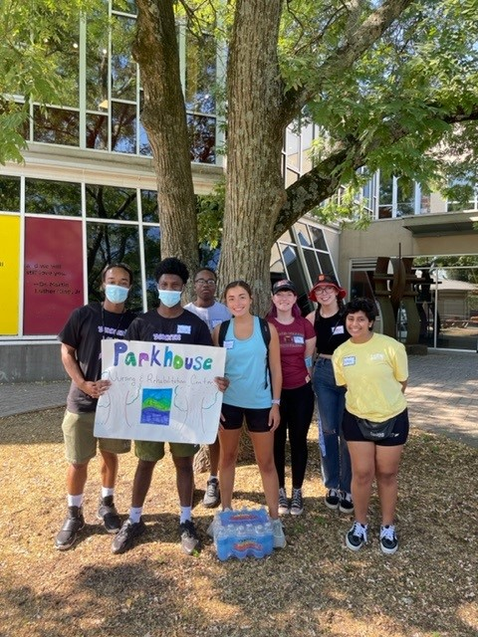
Partners in Service: Collaborating to increase access to service opportunities for students with disabilities
Ang Upright, MA
Joanna Timmerman, MA

Slide 2
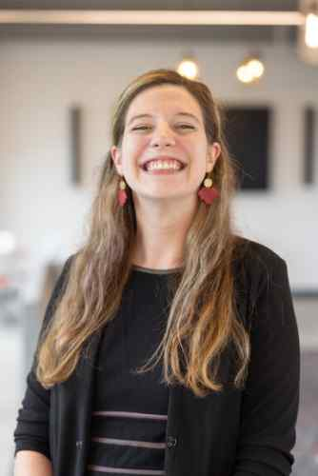
PRESENTER INFORMATION
Ang Upright, MA (she/her)
Associate Director of UCARE
aupright@ursinus.edu
Joanna Timmerman, MA (she/her)
Interim Director of Disability & Access
jtimmerman@ursinus.edu

Slide 3
Have you had any encounters with your institution's service / civic engagement office? Why or why not?

Slide 4
What is UCARE?
The Ursinus Center for Advocacy, Responsibility and Engagement (UCARE) serves as the hub for community engagement and social advocacy at Ursinus College. UCARE’s goal is to help Ursinus College students develop as thoughtful and responsible civic leaders, attuned to the context, strengths, and needs of the communities in which they serve.

Slide 5
Pre-flection

Slide 6
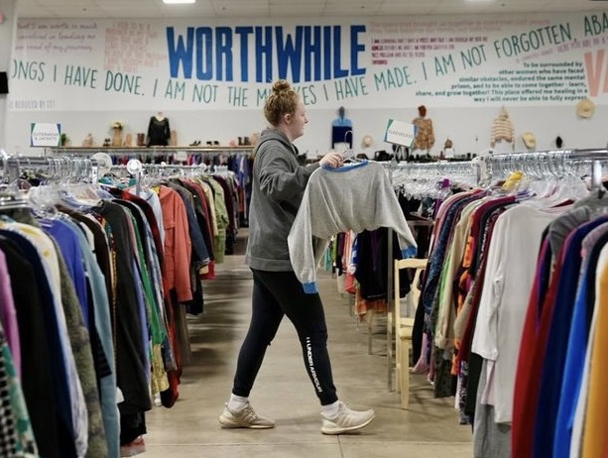
How did we become connected?
Division of Inclusion & Community Engagement
Friendship!
Continued education around & use of the Social Model of Disability
UCARE philosophy grounded in justice & advocacy

Slide 7
Why is our connection important?
Accessibility & inclusion is everyone's job
Lack of clarity around obligation for accommodations in extra-curricular opportunities (Szucs & Harpur, 2023)
Importance of civic engagement and service in college for leadership development, community involvement, and daily well-being (Myers et al, 2018; Manning-Ouellette & Hemer, 2019; Wray-Lake et al, 2017)

Slide 8
What are examples of this collaboration?
Clear descriptions of the setting and work requirements of service sites
Collaboratively developed accessibility statement on all service opportunity announcements
Creation and co-promotion of events designed to help reduce anxieties around civic engagement (e.g., mock election booth)

Slide 9
What are examples of this collaboration?
Presentations to service leaders about accessibility, inclusive language, etc.
Encouraging student advocacy across identities
Prioritizing and incentivizing collaborative training and enrichment

Slide 10
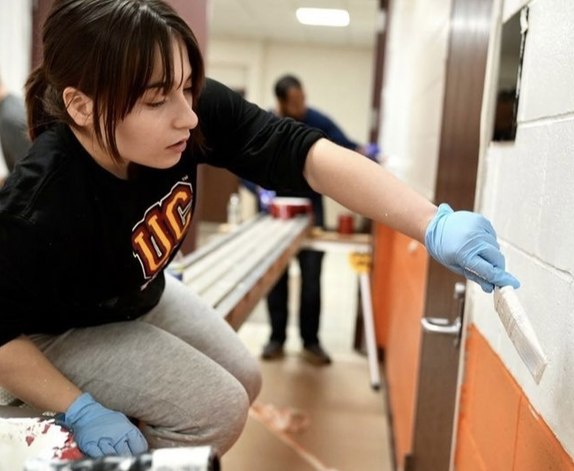
We are committed to creating inclusive and accessible service experiences. While we included some information in the description of the service projects, if you have additional questions or concerns about accessibility or related accommodations needs, please contact Ang Upright aupright@ursinus.edu. Thank you!

Slide 11
Example questions for community partners:
What is the nature of the service project?
Location: indoor / outdoor, inclement weather plan, air conditioning, exposure to allergens (e.g., tree nuts, bees, dust, etc.), wheelchair accessibility
On-site resources: availability of bathrooms (including single use / gender inclusive), water access, number of exits, seating options
Instructions: written versus verbal instructions, availability of preparation ahead of time, who is / how to contact site coordinator

Slide 12
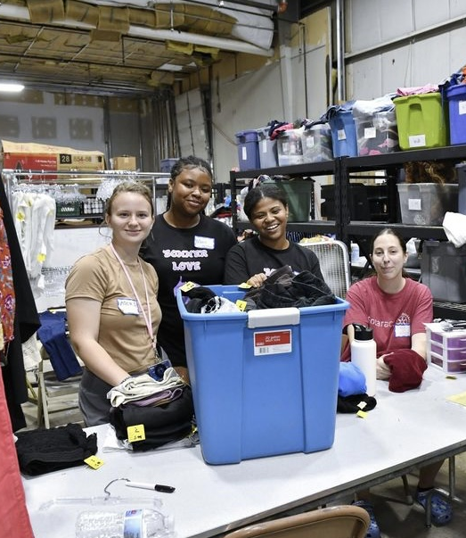
What are outcomes of this collaboration?
Integration of service and disability advocacy (e.g., volunteering with therapy dogs, mentoring adolescents with disabilities, etc.)
Increased involvement by first year students
Long-term service projects
Days of service (Orientation, MLK week)

Slide 13
How can YOU do this at your institution?
Review the information of your "UCARE" office (mission statement, service sites, etc.)
Talk to your students (what matters to them, any observed barriers, etc.)
Contact your colleagues & share at least one strategy
Tobin's "Plus One" method
Share successes!

Slide 14
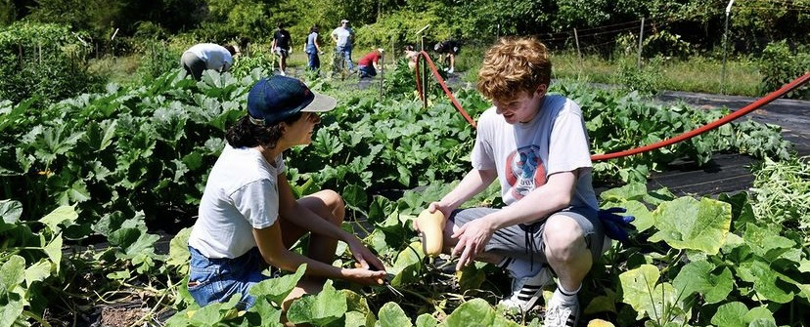
What are your key takeaways? Questions?

