Slide 1
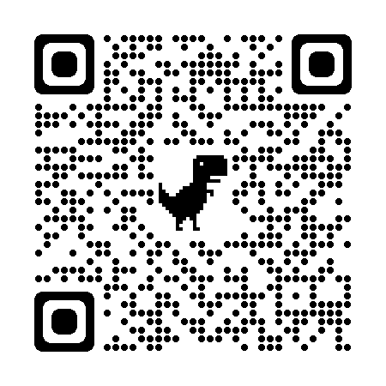
The SWAT Team: Developing Student Workers to Implement Accessibility on Campus
Jordan Colbert, MMFT, ATP
Associate Director of Assistive Technology
Yale University, Student Accessibility Services
E: Jordan.Colbert@yale.edu
IG: @yaleSAS

Slide 2
About Student Accessibility Services at Yale University
Student Accessibility Services at Yale is the office responsible for providing academic accommodations for students with disabilities
Currently servicing 2900+ students (25% of student population)
Managed by 7 staff members (6 accessibility specialists, 1 administrative)
Prior to 21-22 academic year, 4 staff (3 accessibility specialists, 1 admin)

Slide 3
Overview
The Student Workers in Assistive Technology Team
The 3 Phases of Building the SWAT Team
Campus and Administrative Buy-in for the SWAT Team

Slide 4
Important Considerations
Connotations associated with the team/unit names
“Take the meat and leave the bones” principle
Intended to associate with a trained and highly specialized team that addresses problems others are unable to do
Funding and staffing issues
Not all accessibility or disability services may have budget or bandwidth to develop same size of team
Can be adapted to volunteer or smaller scale teams
Campus partners may be able to assist with funding, training, or management

Slide 5
The Student Workers in Assistive Technology (SWAT) Team
Undergraduate and graduate student workers over 2 teams and 6 positions
Accessibility Assistant Unit (Remote)
Graduate Accessibility Assistants
Lead Undergraduate Assistant
Accessibility Assistant
Communication Interpretation and Assistive Technology (CIA) Unit (Hybrid)
Communication Access Assistants
Assistive Technology Assistants
Alternate Format Assistants

Slide 6
Accessibility Assistant (AA) Unit
Unit that specializes in document remediation for faculty and students
Training through WebAIM: Document Accessibility Certificate
Graduate AAs manage teams of AAs work assignments
Responsible for uploads and downloads of course materials
Interact with faculty for support and guidance with materials
Lead AA
Senior member of the team who train and supports AAs
Communicates to team at large and supports social media
AAs
Document remediators

Slide 7
Communication Interpretation and Assistive Technology (CIA) Unit
Graduate students from different disciplines
Involved with direct student training and technology related accommodation facilitation
Directly support the mission, value, and vision of the SAS office through projects
Engages campus partners and student groups through presentations and trainings

Slide 8
CIA Roles and Responsibilities
Communication Access Assistants
Manage captioned media accommodations for faculty videos
Coordinates CART and ASL services for student coursework related needs
Assistive Technology Assistants
Manages notetaking and assistive technology trainings for student accommodations
Generates data and assessment related materials from database for SAS staff
Alternate Format Assistants
Conduct text-to-speech technology trainings
Obtains alternate formats of textbooks for students with accommodations
Manages SAS website updates and accessibility

Slide 9
Accommodations Facilitated by the SWAT Team
Accessible Course Materials
AA Unit and Alternate Format Assistants
Notetaking Technology
Assistive Technology Assistants
Assistive Technology Software and Applications
Assistive Technology Assistants
Captioned Media, Audio Description and CART/ASL
Communication Access Assistants

Slide 10
Leadership Development and Oversight
Each team has a Lead who directs the function of their team
1-hour check-in meeting per team biweekly with Associate Director
1-hour CIA unit meeting biweekly
1-hour SWAT Meeting monthly
Communication via Teams (Graduates) and Slack (AAs)

Slide 11
Questions to Consider
Do any of these roles infringe upon you or your co-workers’ responsibilities?
Does your campus have the appetite for a student-centered team like this?
How might these roles support and free up your office’s functioning?

Slide 12
Building the SWAT Team
A 3-year model

Slide 13
Year 1: Assessment
Understanding what you have and what you need

Slide 14
Assessment of AT Services
What assistive technology do you currently have?
How are accommodations related to AT facilitated?
Who are the main decision-makers for AT?
Which campus partners have a role in accessibility?
What gaps exist in AT and accessibility delivery?

Slide 15
Adapt and Start Small
Available AT
Inventory
Needs
Facilitators
Immediate support
Availability
Campus Support
Identify Allies
Existing Practices
Start as puddy, not playdough
Make assessments, not advisories
Test foundations, not patience

Slide 16
Build the Base
Focus on the low hanging fruit
Find a champion and an eager beaver
Identify the immediate need
Plan to fail in fully addressing it
Take one bite of the elephant
Locate an employee who understands your vision
Partner with them to spread the word
Find one student who is passionate and self-sufficient

Slide 17
Activity Time!
Turn to your neighbor and share one area of AT need on your campus or in your office

Slide 18
Year 2: Development
Gather what you need and build the machine

Slide 19
Deliver a State of the Service Address
Take the opportunity to grab the power players attention at a high-level start of the academic year meeting
Highlight previous successful areas of AT services
Discuss immediate needs that were identified
Explain who helped you and gently mention who blocked you
“…collaborated with X, but wasn’t able to connect with Y and will in the future”
Depict failure as a product of the size of the needs
Shout out your champion and eager beaver
Express optimism and expected success with future support
Notes:
Find an opportunity to get in front of the decision-makers and stakeholders at your university and provide the details of your assessment from year 1. Ideally this will be at a division wide meeting prior or during the first week of the semester. Make the case that your results are critical to the support of the university, its students, and all future endeavors. No matter what you found, do your best to leave a lasting impression of either yourself, your office, or your vision.

Slide 20
Fall of Year 2: Under Promise and Over Deliver
Present one tool that will slightly fill a gap in service
Implement 3 free tools that can be expanded on in 1-2 semesters for full-service delivery
Expand accommodations related to this toolset to demonstrate greater need for support
Focus on developing one area of service per semester
Begin with largest area of deficit in AT delivery
Tell campus partners your next semester plans and ask for support
Find another eager beaver
Leverage their enthusiasm for more bandwidth to take on tasks
Identify volunteer/part-time positions that could be offered for experience

Slide 21
Get to Work: Utilizing Your Eager Beavers
Eager Beaver 1
Eagar Beaver 2
Begin training students on existing AT
Explore peer-institutions processes for guidance
Establish email account for communications
Delegate tedious process tasks for staff efficiency
Begin remediation of priority course materials
Explore communication tools for best team results
Enlist an undergraduate volunteer/hire to support remediation efforts
Obtain access to communicate with faculty for materials harvest

Slide 22
Spring of Year 2: Capitalize on Efficiency
Highlight the office support and student growth as reflective of additional student worker
Point to faculty support as a means of building relationships
“Help us, help you” mentality
Explain that good work means more work, and more work needs more support
Double trainer role need for accommodation implementation
Remove onus of AT knowledge from FTE to student workers
Introduce 5 volunteer or student workers with lower hour expectation and wages than initial hires

Slide 23
Use Engagement to Differentiate Roles
Track numbers for proof of momentum
AT training engagements
Documents remediated
Faculty contacts-include the champion!
New responsibilities through need identification
Create team meetings once per month
Create new titles for differing roles and responsibilities
Let roles train their teammates on their focus
Bring campus supports to meetings for introductions
Assign homework related to spreading awareness
Ex. tell one friend or professor about your role in accessibility

Slide 24
No Growing Pains, No Growing Gains
Continue to ask for more areas of influence through secondary needs
What supports were neglected while addressing the priority need?
Do campus partners need support?
Are there office projects that staff cannot complete due to constant “fires”?
The increase in tasks may cause some students to reconsider commitments within the roles
This provides a need for growth to accomplish goals
Staff and administration may question impact to their own goals
Resistance can be redirected as new opportunities for personal growth
Emphasize student development and service delivery

Slide 25
Reflect on Progress for Summer Projects
Survey interest in summer positions whether paid or volunteer
Use accomplishments to justify competency
Feedback surveys from students and population metrics
Use student excitement and campus appetite for guidance
Expand expectations and utilize vision for additional hiring
Notes:
Use the summer to train new members and clean up processes

Slide 26
What is the greatest barrier to accessibility program success?
Hint: It’s not effort!

Slide 27
Year 3: Efficacy
Let the machine do the work

Slide 28
Set the Tone Before the Year Starts
Hold an entire team meeting and announce lead roles
Establish clear expectations of the importance of the work
Inform faculty and campus partners of team size and scope
Create opportunities for community engagement
Drop-in technology hours once weekly
Attendance at orientations
Team SWAG- shirts, flyers, stickers
Notes:
Manuals are helpful for onboarding and clear expectations

Slide 29
Utilize Leads to Improve Delivery
Ensure that the Leads have varied skillsets
Establish biweekly offsetting team meetings
30 mins to 1 hour MAX
Check-in on workloads and communications
Elicit creative solutions for common problems
Remember student-workers are not FTE

Slide 30
Continual Improvement: Anything You Can Do I Can Do Better
Create immediate feedback opportunities
Minimize tedium
Maximize innovation
Population growth = SWAT growth
Identify new needs assessment
Generate campus excitement
Re-engage champions for exposure
Highlight senior SWAT members

Slide 31
Campus Immersion
Provide opportunities for engagement with campus events
1
Present as a faculty resource for AT accommodation training
2
Adapt to student schedules and meeting spaces
3

Slide 32
Who on your campus might resist your SWAT Team development?

Slide 33
Campus and Administrative Buy-In

Slide 34
Asking Administration for Resources can feel like SpongeBob in Sandy’s Tree Dome

Slide 35
Campus Stakeholders with skin in the game!
Includes:
Champions
SWAT Team Members
Campus Partners who receive support or collaborate
Student Orgs that focus on DEIA and community building

Slide 36
“Help us, help you” Approach to Campus Detractors
Leverage the inclusivity and minimal lift related to implementation
Ex: Librarians can focus on research skill development without worrying about accessibility of research materials
Ex: Students do not have to ask for alternate materials or specific tools
Ex: Less nuanced faculty support through training and workshops for greater understanding

Slide 37
Administration: It Affects the Bottom Line $$$
Campus culture of accessibility has an impact on student choice and retention
Continual increase of students with accessibility needs are entering higher education with AT experience
Creates a proactive rather than reactive approach to student support
It’s harder to pay for staffing than to find volunteers and experience-hungry students

Slide 38
Administration: Shows Robust Care
Enables peer-to-peer support and community on campus
Expresses a commitment to an inclusive classroom environment
Spreads awareness of resources through collaboration
Develops professional accessibility knowledge in students
Builds bridges between faculty, disability offices, and student groups

Slide 39
The Keys to Buy-In
Business is done over lunch and the golf course
It’s hard to be forgotten if you’re always around
You catch more flies with honey than with vinegar
Don’t just talk about it, be about it
Bring solutions, not problems
The President was in an entry level job once

Slide 40
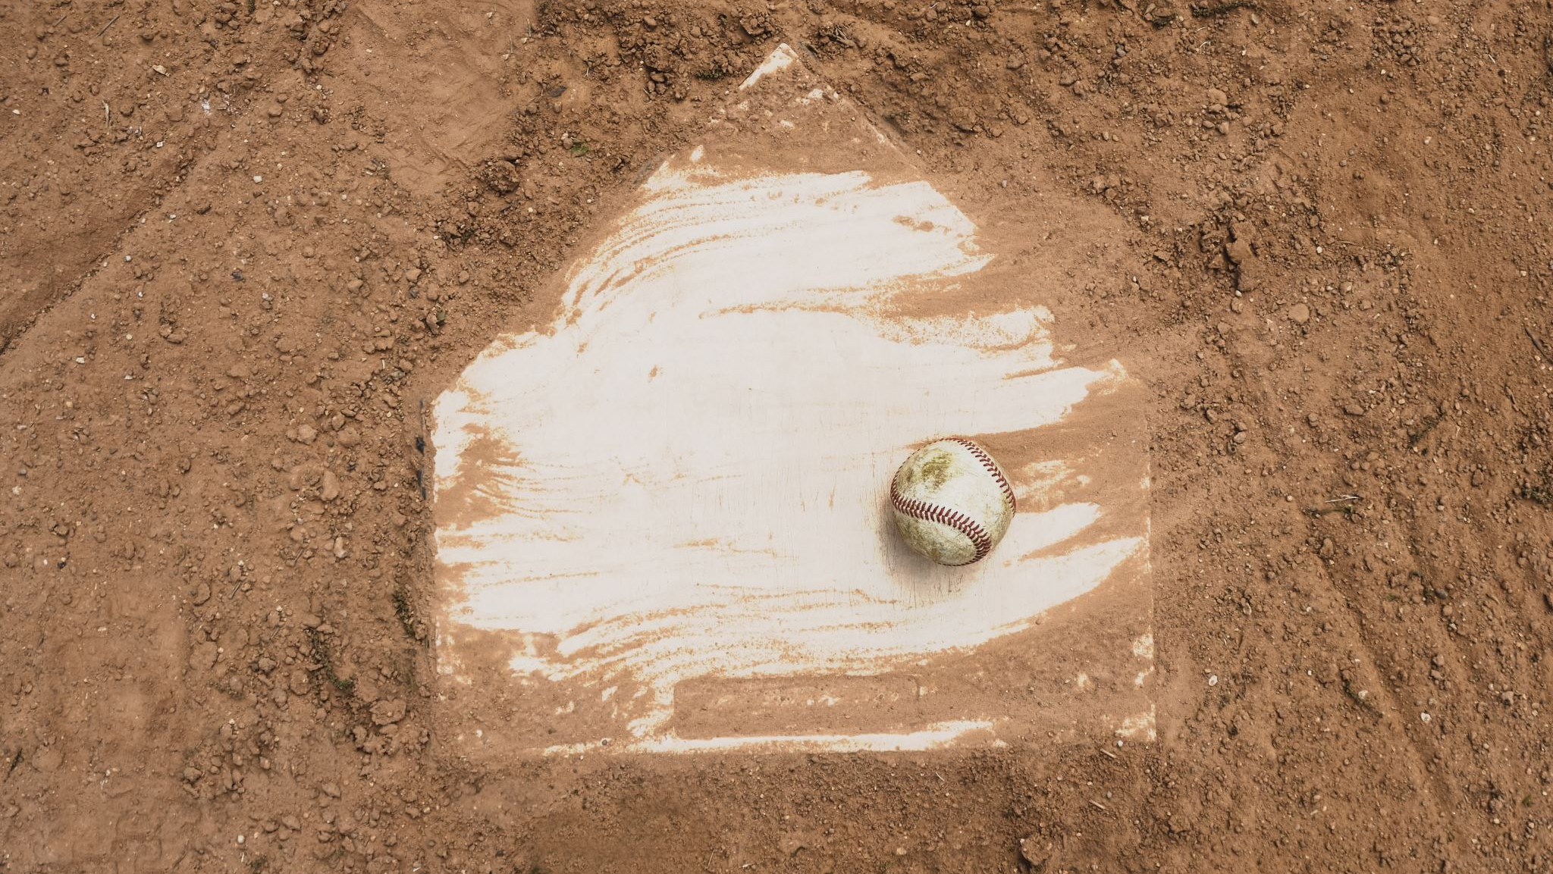
If You Build It, They Will Come

Slide 41
Questions? Feel free to contact me at Jordan.Colbert@yale.edu

