Slide 1
How to NOT Feel So Alone: Maximizing Community Partnerships
Presented by
Michelle Mitchell, M.Ed., CRC, Lehigh Carbon Community College
Jennifer C. Osinski, M.Ed., M.S., Bucks County Community College

Slide 2
Objectives
Student Statistics
Student and Staff Ratios
DS Provider Responsibilities
Campus Supports
Community Supports
Breaking Down the Silos

Slide 3
Padlet
Tell people how to get on Padlet!
https://padlet.com/mmitchell266/FeelingNotAlonePoll

Slide 4
General Student Statistics
IES: NCES Statistics Graph
In 2019–20 reported having a disability
21% of undergraduates
11% of postbaccalaureate students
Notes:
Defined as those who reported having deafness or serious difficulty hearing; blindness or serious difficulty seeing; serious difficulty concentrating, remembering, or making decisions because of a physical, mental, or emotional condition; or serious difficulty walking or climbing stairs
Among undergraduates, the percentage who reported having a disability was
18 percent for male students;
22 percent for female students; and
54 percent for nonbinary students.1
By race/ethnicity, the percentage of undergraduates who had a disability was
25 percent for students of Two or more races;
24 percent for American Indian/Alaska Native students;
22 percent for Pacific Islander students;
21 percent for Hispanic students;
21 percent for White students;
18 percent for Black students; and
14 percent for Asian students.

Slide 5
General Student Statistics (continued)
Key Findings
Enrollment
Informing Colleges of Disability
Accommodations in College
Use of College Academic Support
Notes:
Use of Supports among Students with Disabilities and Special Needs in College uses data from the High School Longitudinal Study of 2009, a national study of more than 23,000 students who were in ninth grade in 2009. Students answered surveys between 2009 and 2016, and the sample was limited to students who ever reported a disability in grades K-12 and enrolled in college in February 2016. This Data Point also examines whether students use academic support services, seek help, or enroll in remedial courses during college.
Key Findings
Enrollment
The majority of students with disabilities who enrolled in college went to a 4-year institution. Sixty-nine percent of students with disabilities went to 4-year colleges and 28 percent went to 2-year colleges.
Informing Colleges of Disability
Sixty-five percent of students who ever had a reported disability in earlier years responded that the disability was not present in college.
Among students who responded that they did have a disability while attending college, about one-third of students (37 percent) informed their college.
At both 4-year and 2-year colleges, between 12 and 13 percent of students informed their college of current disabilities.
Accommodations in College
Students at 4-year colleges reported receiving accommodations or services at a higher rate (85 percent) than students at 2-year colleges (57 percent).
Use of College Academic Support
Students at 2-year colleges were more likely to take remedial courses compared to students at 4-year colleges. Forty-four percent of students who reported disabilities at 2-year colleges took remedial courses, compared to 21 percent of peers who reported disabilities at 4-year colleges. A difference in remedial coursetaking by college level is also present for students who did not report a disability (43 and 14 percent, respectively, for 2- and 4-year colleges).
Students who reported a disability were more likely to use academic services, compared to their peers. Sixty-one percent of students who reported disability received help from a school office or department versus 51 percent of students who did not report a disability.
Students who attended 4-year colleges used academic services and requested help at higher rates than students at 2-year colleges. This was true for students with disabilities and students who did not report a disability in college.

Slide 6
DSO Job Responsibilities and Student-Staff Ratios
 | Average Number of Registered Students* | Average Number of Full-Time DRO Staff** | Student to Full-Time Staff Ratio
Average Student-Staff Ratios by Institutional Size
<1,500 students | 144 | 1 | 144:1
1,500-9,999 students | 385 | 3 | 128:1
10,000-19,999 students | 1053 | 6 | 176:1
20,000-29,999 students | 1,642 | 8 | 205:1
30,000 or higher students | 2,554 | 17 | 150:1
Notes:
BCCC 2 staff for 520 Students 260:1
LCCC 2 staff for 412 Students 206:1
Number of Full-Time DRO Employees
Across all respondents, 40% reported there are 1-2 full-time employees in the DRO. (See Table and Figure IV-1)
However, staffing patterns are different at different types of institutions. Similar to findings in 2018, the majority (57%) of Doctoral Universities indicated there were seven or more full-time DRO employees while 56% of Baccalaureate and 49% of Associates Colleges reported one to two full-time staff in the DRO. (See Table IV-1a)
Institutional size (i.e., total student enrollment) reflects clear staffing trends with the number of full-time DRO staff increasing in relation to campus size. (See Table IV-1b)
Average Number of DRO Staff Members
Disability resource offices are staffed in different ways with a variety of personnel and funding structures. Respondents were asked to list the current number of staff members in five categories: full-time, part-time, contract, student, and volunteers. Numerical averages in each category are reported for each type of institution and for each size of institution. (See Table IV-2)
Institutions with the largest overall student enrollments reported the highest average number of full-time DRO employees. When compared to 2018 data, however, average staffing levels at these large institutions reflect some changes. While full-time staff numbers are reported as higher in 2022 (an average of 17 compared to 13 in 2018), average numbers also reflect fewer part-time staff (7 in 2022 vs 10 in 2018 ) and far fewer student employees (20 in 2022 vs. 50 in 2018).
Across all institutional types and sizes there was a notable decrease in 2022 in the average number of volunteers assisting the DRO.
Common Job Titles and Roles of Full-Time Employees
Disability resource offices structure the role and work of full-time employees in a variety of ways. Similar to staffing patterns reported in 2018, DROs most frequently reported full-time job functions for operations/office manager (reported by 50% of campuses), test accommodations (54% of campuses) and individual work with students such as coaching or case management (reported on 54% of campuses). (See Table and Figure IV-3)
Other common full-time roles include overseeing and producing alternate format (reported by 41% of campuses) and coordinating and supporting technology use (36% of campuses).
Respondents provided a number of valuable comments and details about job functions of full-time employees. Several respondents noted that full-time staff have generalist duties in the DRO, including for example DROs that are one-person offices.
Student-Staff Ratios
Combining the data on average number of full-time staff (see Table IV-2) with the data on average number of registered students (see Table III-6), an average student-staff ratio can be calculated. Looking at this ratio sorted by institutional size provides a feasible benchmark by which campuses can compare their own staffing levels. (See Table IV-4)
The highest average student to staff ratio (205:1) is reported by campuses with a total student enrollment of 20,000-29,999 students. The lowest average student to staff ratio (128:1) is found on campuses with 1,500-9,999 total student enrollment. (See Table IV-4)

Slide 7
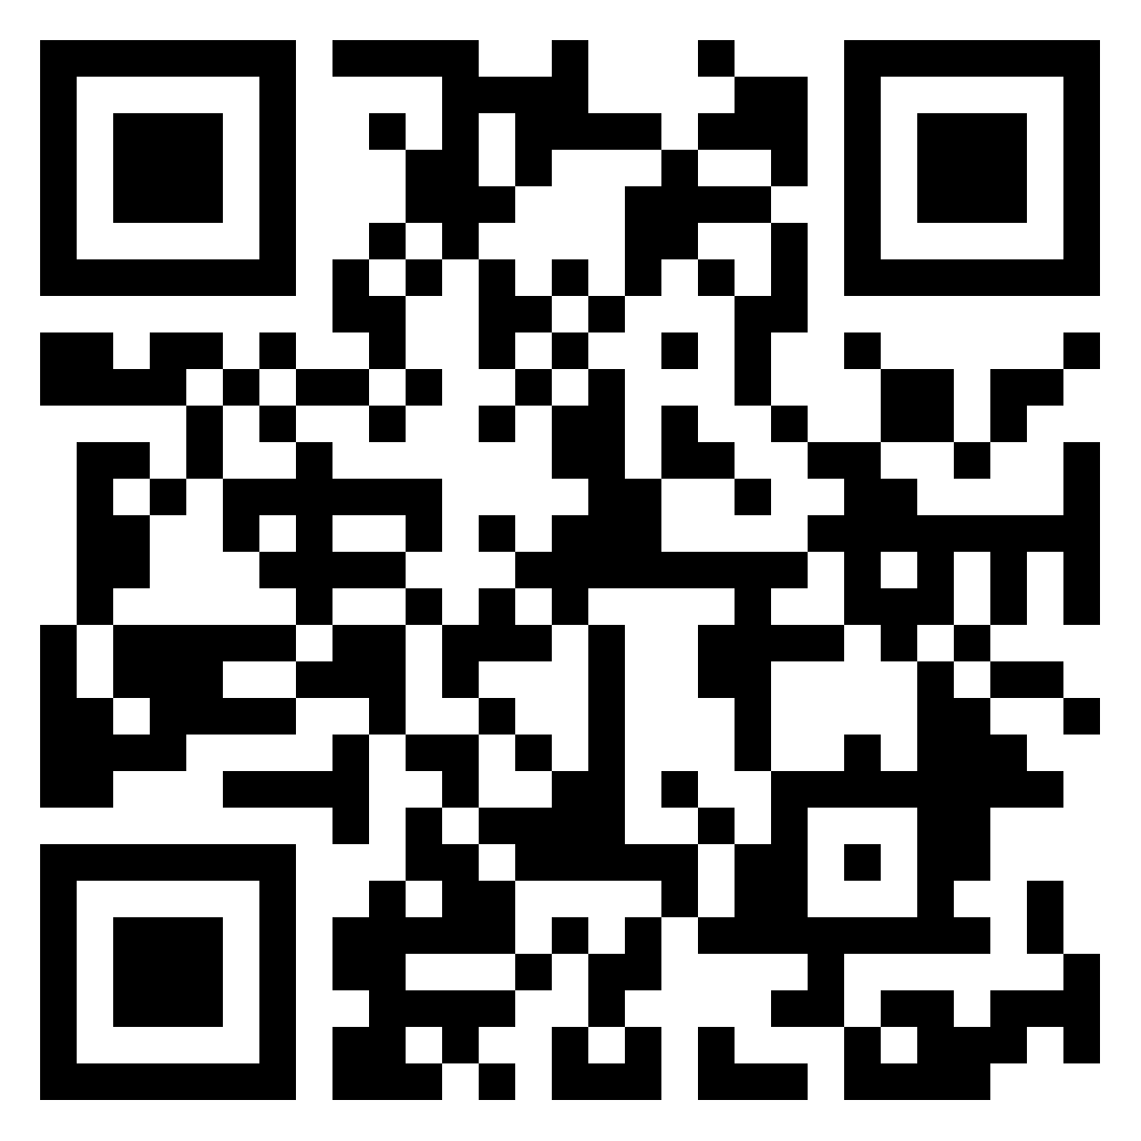
Question
How many students do you serve and how many staff are in your office?
https://padlet.com/mmitchell266/FeelingNotAlonePoll

Slide 8
DS Provider Responsibilities
Meet
Review
Reassess
Connect
Notes:
Meet With students with disabilities to determine access and accommodation needs
Review documentation to assure appropriate accommodations are being offered and student meets the definition of student with a disability
Reassess to make sure accommodations are working well in classes and make adjustments as needed
Connect students to appropriate university/college, community resources

Slide 9
Campus Supports
Advising
Counseling
Career Services
Health Services
Tutoring
Specialty Support Programs
Veterans Groups

Slide 10
Community Supports

Slide 11
Breaking Down the Silos
Targeted Selection
Communication
Information Sharing
Removing the Barrier of Fear
Notes:
We know you don't have all the time in the world so targeting the selection of folks you would like to connect with is important. Based upon those issues that are rising currently for your office
Start the lines of communication… Coffee, lunch, quick walk by conversation
Start helping folks see what you're doing and how that overlaps with what their current role is at the college and vice versa so that the collaboration can be mutually beneficial
A lot of times folks don't want to "step into our lane" because they fear they're going to say something wrong, do something wrong, or just don't know how to approach/communicate with folks with disabilities… Sometimes a little modeling can go a long way

Slide 12
Campus/Community Supports
In this Padlet, tell us what are your current on campus resources and off-campus resources you are using.
https://padlet.com/mmitchell266/Campuscommunitysupports

Slide 13
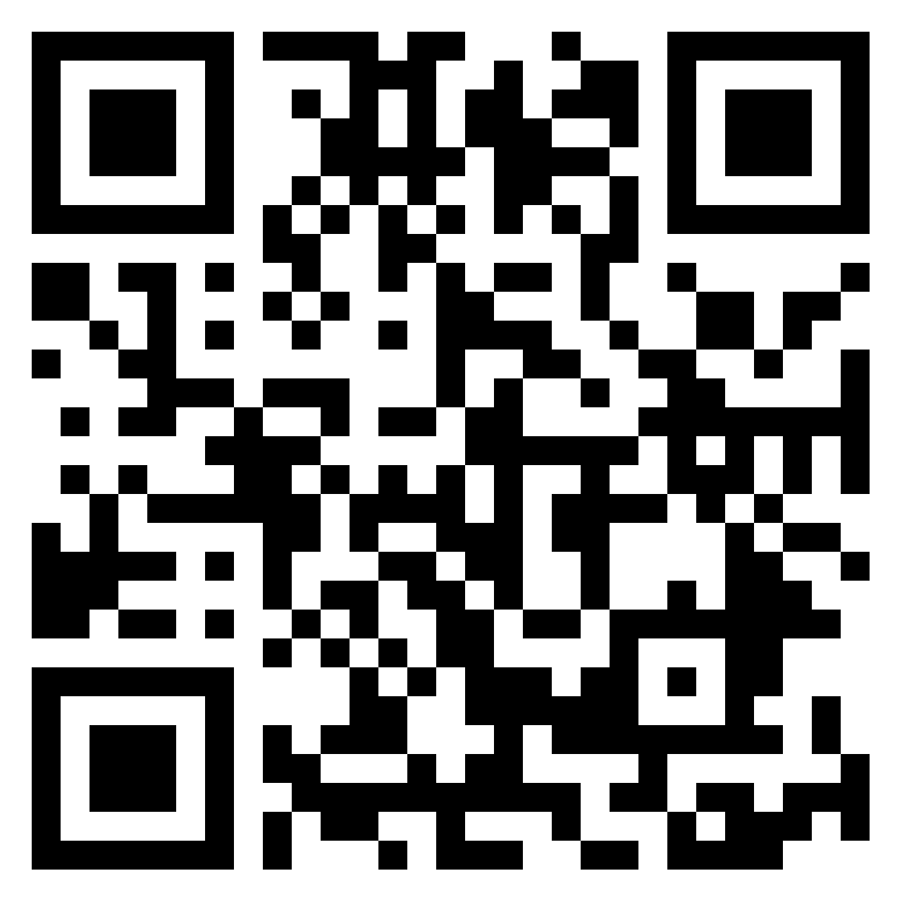
Silo Breaking Resources
In this Padlet, tell us what resources you would like to start breaking down the silos
https://padlet.com/mmitchell266/SiloBreakingResources

Slide 14
O
W

Slide 15
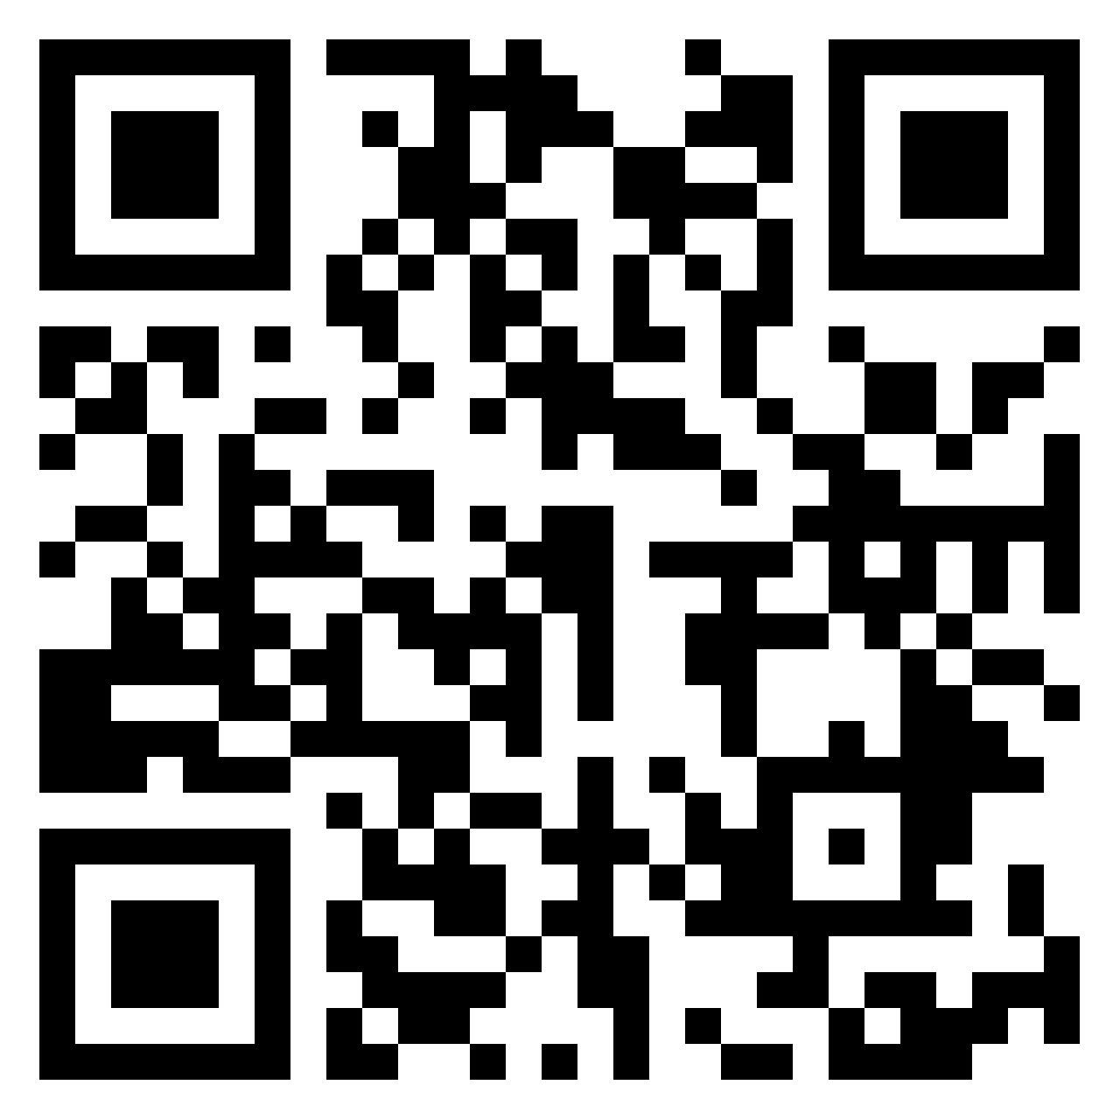
Questions?
In this Padlet, tell us what questions we still have not answered
https://padlet.com/mmitchell266/Questions

Slide 16
References
Digest of Education Statistics. (2023, June). Number and percentage distribution of students enrolled in postsecondary institutions, by level, disability status, and selected student characteristics: Academic year 2019-20. Digest of Education Statistics. https://nces.ed.gov/programs/digest/d22/tables/dt22_311.10.asp
IES: National Center for Education Statistics (NCES). (2023). A Majority of College Students with Disabilities Do Not Inform School, New NCES Data Show. IES: NCES Fast Facts. https://nces.ed.gov/whatsnew/press_releases/4_26_2022.asp
IES: National Center for Education Statistics (NCES). (2023). Students with disabilities. IES: NCES Fast Facts. https://nces.ed.gov/fastfacts/display.asp?id=60
Postsecondary National Policy Institute (PNPI). (2023, November). Students with Disabilities in Higher Education . Postsecondary National Policy Institute (PNPI). chrome-extension://efaidnbmnnnibpcajpcglclefindmkaj/https://pnpi.org/wp-content/uploads/2023/11/StudentswithDisabilities-Nov-2023.pdf
Scott, S. S. (2023, April). The 2022 Biennial AHEAD Survey: Disability Resource Office Structures and Programs Summary Report. The Association on Higher Education and Disability (AHEAD). https://www.ahead.org/blogs/ahead/2021/09/20/the-biennial-ahead-survey-report-is-now-available

