Slide 1
Accessibility, Identity, and Campus Partnerships: Engaging Students Who Don't Identify as Disabled
Emmett Binkowski, MSW
Disability Specialist, University of Pennsylvania

Slide 2
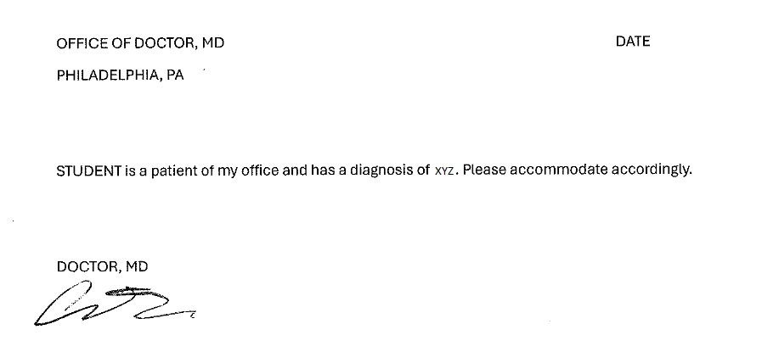

Slide 3
Key Questions
Are there students who might qualify for accommodations who don't register with Disability Services?
How does identity impact student engagement with Disability Services?
How can campus partners work together to improve student access?

Slide 4
Defining Disability
"The term “disability” means, with respect to an individual—
(A) a physical or mental impairment that substantially limits one or more major life activities of such individual;
(B) a record of such an impairment; or
(C) being regarded as having such an impairment"
(Americans with Disabilities Act, 1990, As Amended)

Slide 5
Research - Prevalence
How many students in higher ed have a disability?
19% of undergraduates reported a disability in the 2015-16 academic year, up from 11% in 2008 (NCES, 2018; Madaus & Kunkes, 2023)
Among students who ever had a reported disability since 9th grade: 37% told their college about their disability in 2016 (Adam & Warner-Griffin, National Center for Education Statistics, 2022)
Identification may change over time
Aquino and Bittinger (2019) found that 59% of students who self-identified as having a disability in their first year no longer identified two years later.

Slide 6
Research: Qualitative Experiences of Students
Laura Murray (2017):
Why do some students choose not to use accommodations?
Top reason: ‘I don’t need them’
‘I don’t identify as disabled’ was the second-most common reason
Some students didn’t realize that their diagnosis would “count” as a disability
Belief that Disability Services is only for physical disabilities
Some students thought registering for accommodations would reflect badly on them with instructors
"Fear of being perceived as somehow exploiting the system for personal gain”

Slide 7
Research: Qualitative Experiences of Students
Making Meaning: O'Shea & Meyer (2016)
Students with nonvisible disabilities may construct their disability as part of their self-identity; they may see it as a "minor irritation" to overcome; or they might reject the label "disabled" completely
Students who integrated their disability into their identity may be more likely to disclose it

Slide 8
Research: Stigma
Parsons et al (2023), Ontario:
Students reported overwhelmingly positive interactions with faculty, but every student had at least one negative experience
Instructors who implied a student was "faking" their disability
Forgetting to implement accommodations (such as sending exams to the testing center on time)
Discussing accommodations in front of other students

Slide 9
Research: Stigma
Grimes et al. (2020), Australia:
28% of students who chose not to disclose their disability mentioned stigma as a contributing factor
Negative comments from teachers, admin staff, parents, and peers
Students anticipated negative reactions to disclosure, both at university and future workplaces
Internalized stigma leaves students feeling ashamed, believing they are less academically capable than peers
Stigma decreases the chances that students will ask for help from instructors and peers (even when students recognized that they needed support)

Slide 10
Research - Outcomes
Is non-identification a problem?
Chiu et al. (2019) found that GPA trajectory improved after registering with Disability Services, but racial disparities persisted
Self-advocacy skills are associated with higher GPA in students with disabilities (Fleming et al. 2017)
Schechter (2018) found that students who registered with Disability Services in their first year were more confident that they would graduate, compared to those who registered later
Students with a disability request academic supports at a higher rate and use more academic services than non-disabled students (such as writing centers and tutoring programs) (NCES)

Slide 11
The Impact of COVID-19
Potential increases in the number of disabled students
Long COVID and other chronic health conditions
Mental health conditions: Students surveyed in 2020 reported significantly higher stress, anxiety, and depression than in 2016 (Roche et al., 2022)
Increased attention to accessibility (especially re: remote learning)
"Accidental" universal design (Behling et al., 2021)

Slide 12
Research
Recent trends in Disability Services: Kunkes & Warren (2023)
Shift in focus: access is not solely for legal compliance, but a moral obligation to promote equity and inclusion
Requires less emphasis on the medical model of disability
Aspirational (social justice as the goal)

Slide 13
Scenario 1
Alex, an Engineering major in their junior year, visits your office during drop-in hours to ask about tutoring resources.
Then they mention: "I could really use help with keeping track of everything. I have ADHD, but my parents didn't want me to go on medication, so nothing ever happened."

Slide 14
Scenario 2
You meet with a graduate student named Max. He was a student-athlete as an undergraduate.
His academic advisor referred him to Disability Services because he's having trouble finishing exams.
When you bring up extended time, Max says:
"I really do need more time to finish all the questions, but if I take my exams at the testing center then my friends will notice I'm not in the classroom. I don't want them to know that I have accommodations. They know about my concussions, but they think I should just push through it."

Slide 15
Key Takeaways
Engaging with students:
Educating students about their rights and responsibilities
Building self-advocacy skills
Emphasizing the importance of consent and confidentiality
Recognizing that identity and disability status can be fluid

Slide 16
Key Takeaways
Campus-wide efforts:
Encouraging referrals while decreasing stigma
Focusing on social justice and access, not just legal compliance
Including disability in DEIB efforts on campus

Slide 17
Q&A
Email me! Ebink@upenn.edu

Slide 18
References
Aquino & Bittinger (2019). The Self (un)Identification of Disability in Higher Education. Journal of Postsecondary Education and Disability, 32(1), 5-19.
Behling, K., Pillette, K., & Bibeau, L. (2021). Accidental UDL: A silver lining of the COVID pandemic. Thriving in Academe, 39(3). www.nea.org/sites/de- fault/files/2021-10/Thriving%20Sept%202021.pdf
Chiu, Y. J., Chang, H. V., Johnston, A., Nascimento, M., Herbert, J. T., & Niu, X. M. (2019). Impact of Disability Services on Academic Achievement Among College Students with Disabilities. Journal of Postsecondary Education and Disability, 32(3), 227–245.
Fleming, A. R., Plotner, A. J., & Oertle, K. M. (2017). College Students with Disabilities : The Relationship Between Student Characteristics , the Academic Environment , and Performance. Journal of Postsecondary Education and Disability, 30(3), 209–221.
Grimes, S., Southgate, E., Scevak, J., & Buchanan, R. (2020). University Student Experiences of Disability and the Influence of Stigma on Institutional Non-Disclosure and Learning. Journal of Postsecondary Education and Disability, 33(1), 23–37.
Kunkes, I. B., & Warren, C. (2023). Moving from Compliance to Social Justice and Access : Applying AHEAD’s Revised Code of Ethics , Professional Competencies , and Program Standards. Journal of Postsecondary Education and Disability, 36(4), 387–392.

Slide 19
References
Madaus, Joseph W.; Kunkes, I. B. (2023). The (Modern) History of Disability Services in higher education. Journal of Postsecondary Education and Disability, 36(4), 319–329.
National Center for Education Statistics (2018). Digest of education statistics, 2017 (205-016). U.S. Department of Education.
O’Shea, A., & Meyer, R. H. (2016). A Qualitative Investigation of the Motivation of College Students with Nonvisible Disabilities to Utilize Disability Services. Journal of Postsecondary Education and Disability, 29(1), 5–23.
Parsons, J. M., Mccoll, M. A., Martin, A., & Reynard, D. (2023). Transition and Accommodation Experiences of Students with Disabilities : A Qualitative Study. Journal of Postsecondary Education and Disability, 36(2), 179–192.
Roche, A. I., Holdefer, P. J., & Thomas, E. B. K., (2022). College student mental health: Under- standing changes in psychological symptoms in the context of the COVID-19 pandemic in the United States. Curr Psychol. https://doi. org/10.1007/s12144-022-03193-w
Schechter, J. (2018). University Students with Disabilities: Factors that Contribute to Their Self-Predicted Likelihood of Graduation. Journal of Postsecondary Education and Disability, 31(4), 335–346.

Slide 20
References
Snyder, T.D., de Brey, C., and Dillow, S.A. (2019). Digest of Education Statistics 2017 (NCES 2018-070).
National Center for Education Statistics, Institute of Education Sciences, U.S. Department of Education.

